Slide 1
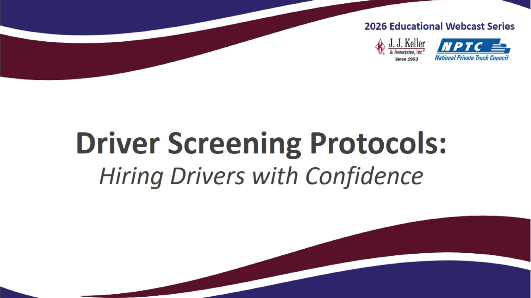
Driver Screening Protocols:
Hiring Drivers with Confidence

Slide 2
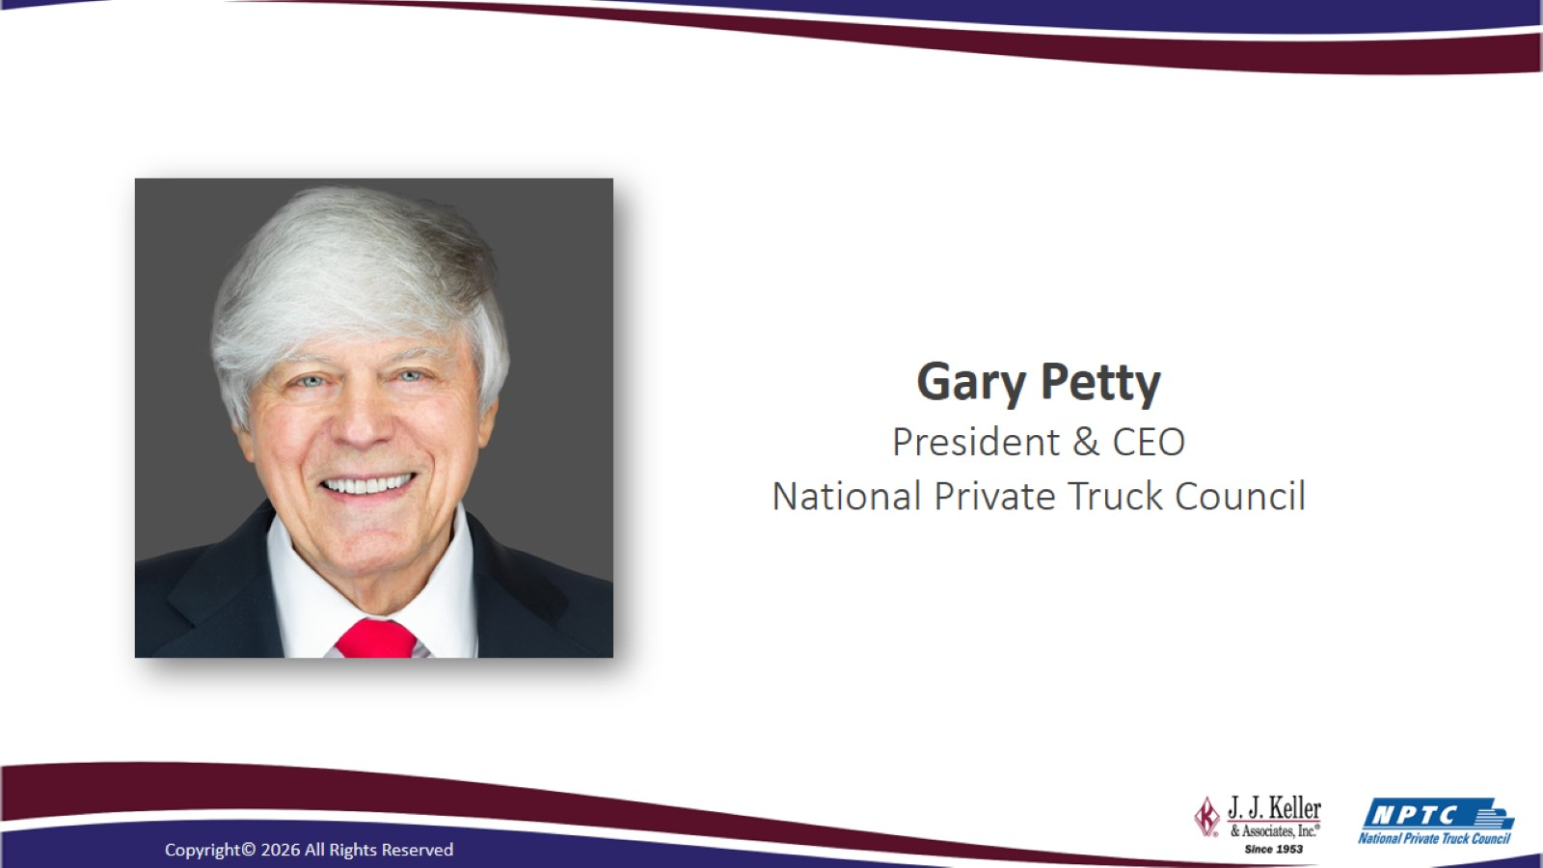

Slide 3
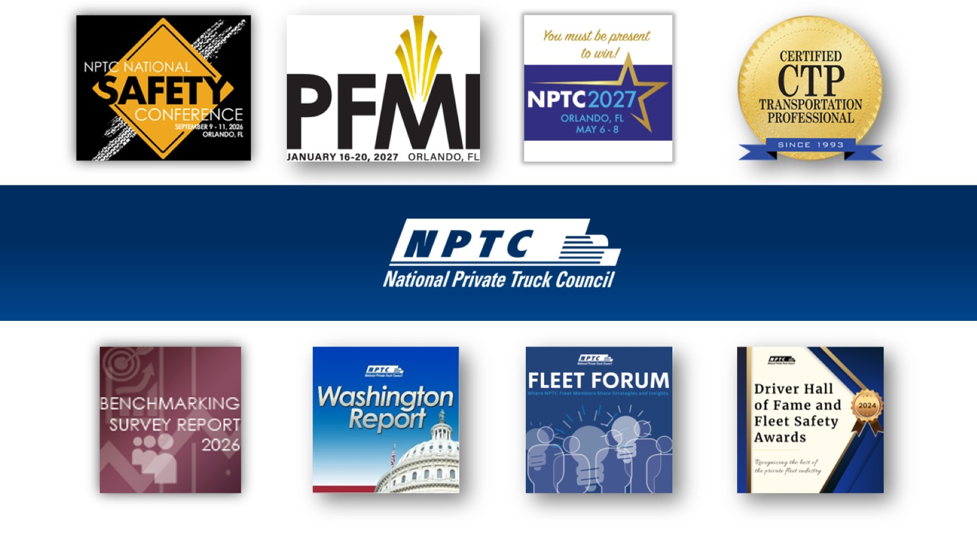

Slide 4
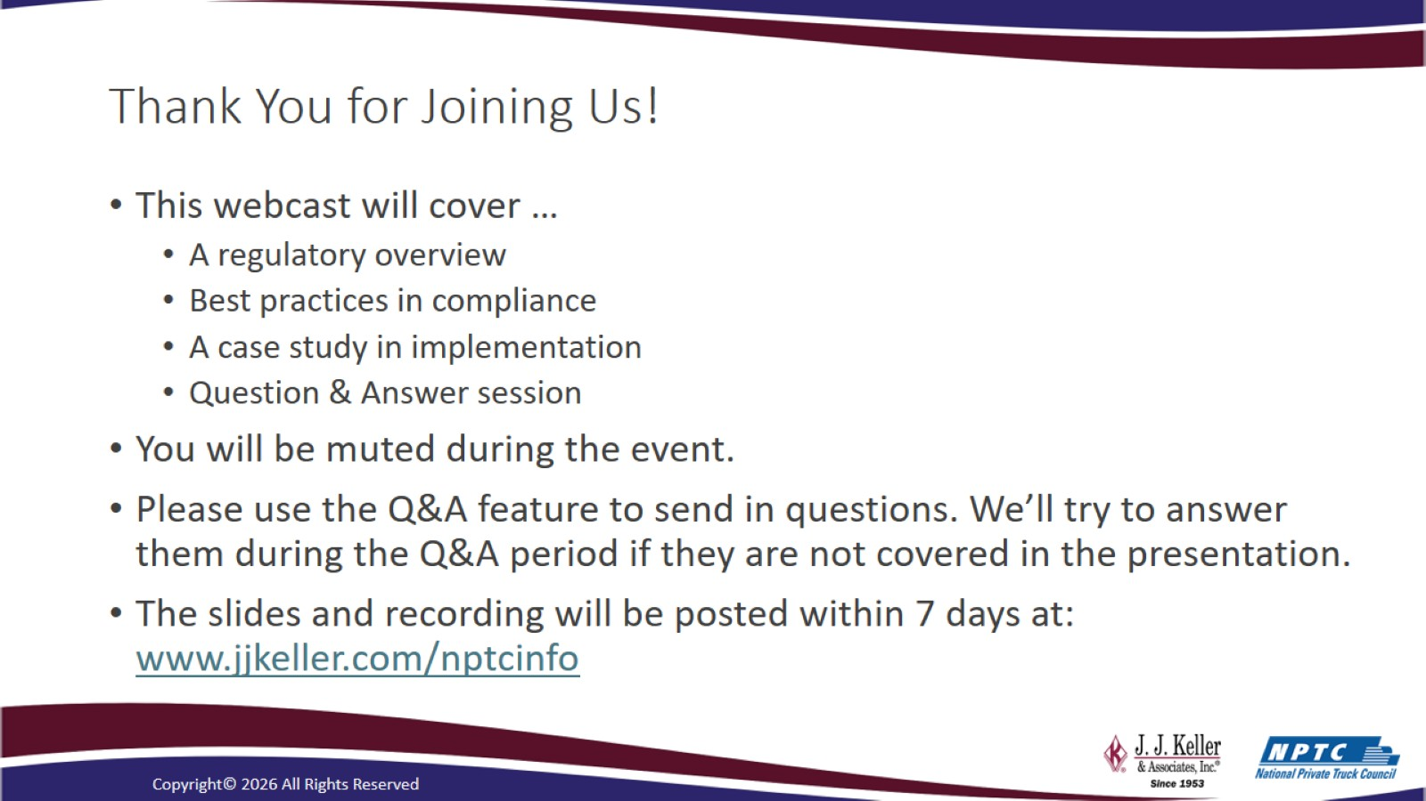
Thank You for Joining Us!

Slide 5
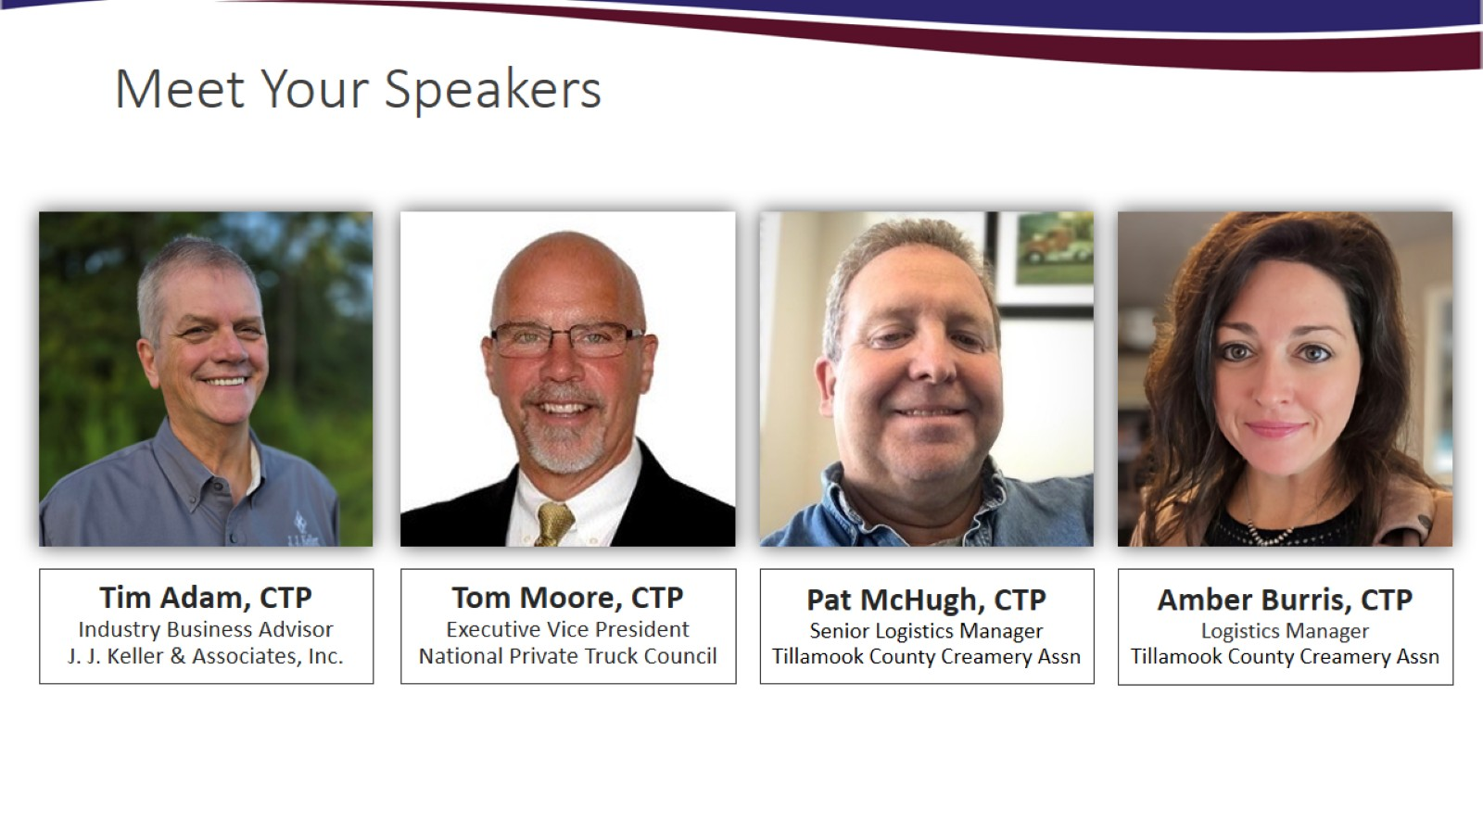
Meet Your Speakers

Slide 6
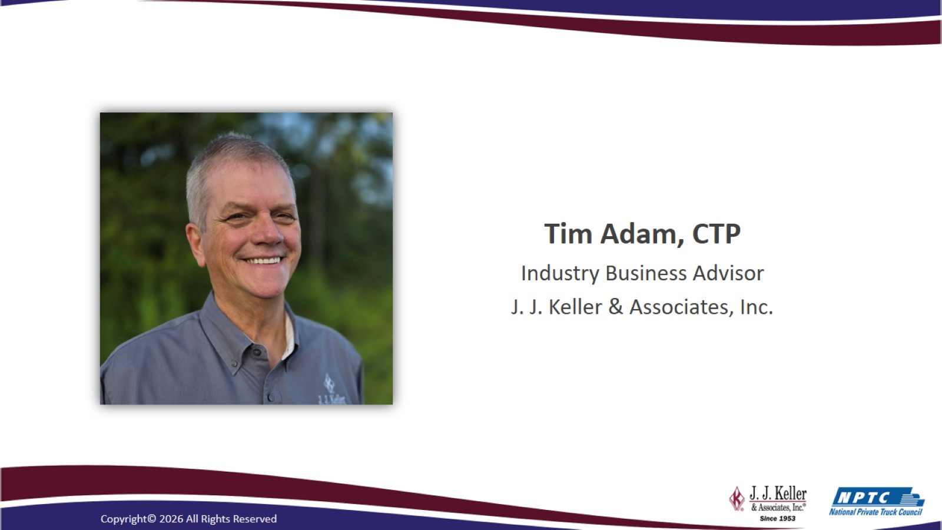

Slide 7
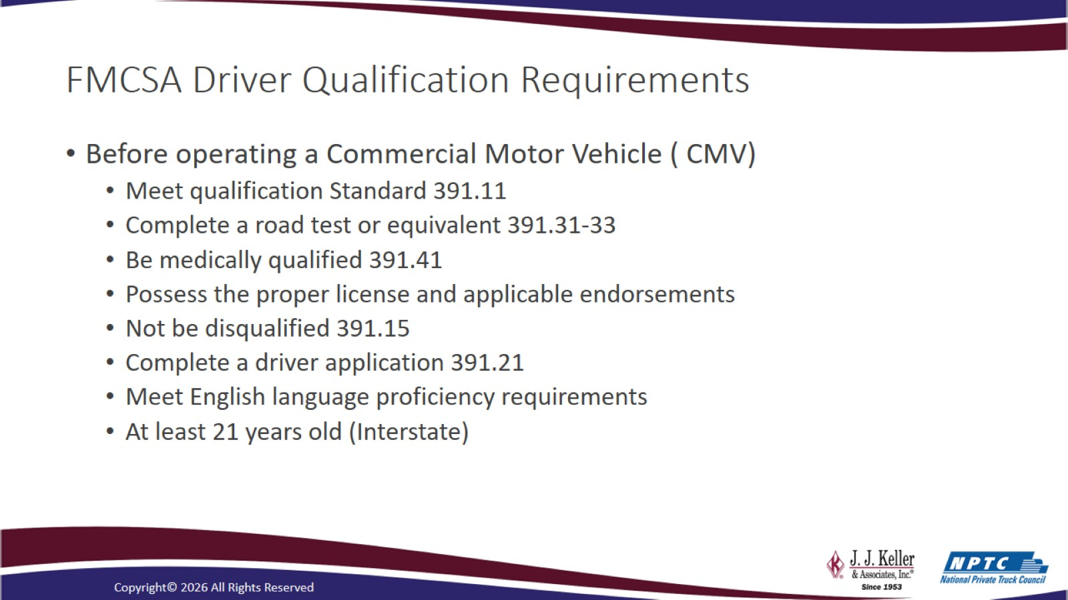
FMCSA Driver Qualification Requirements

Slide 8
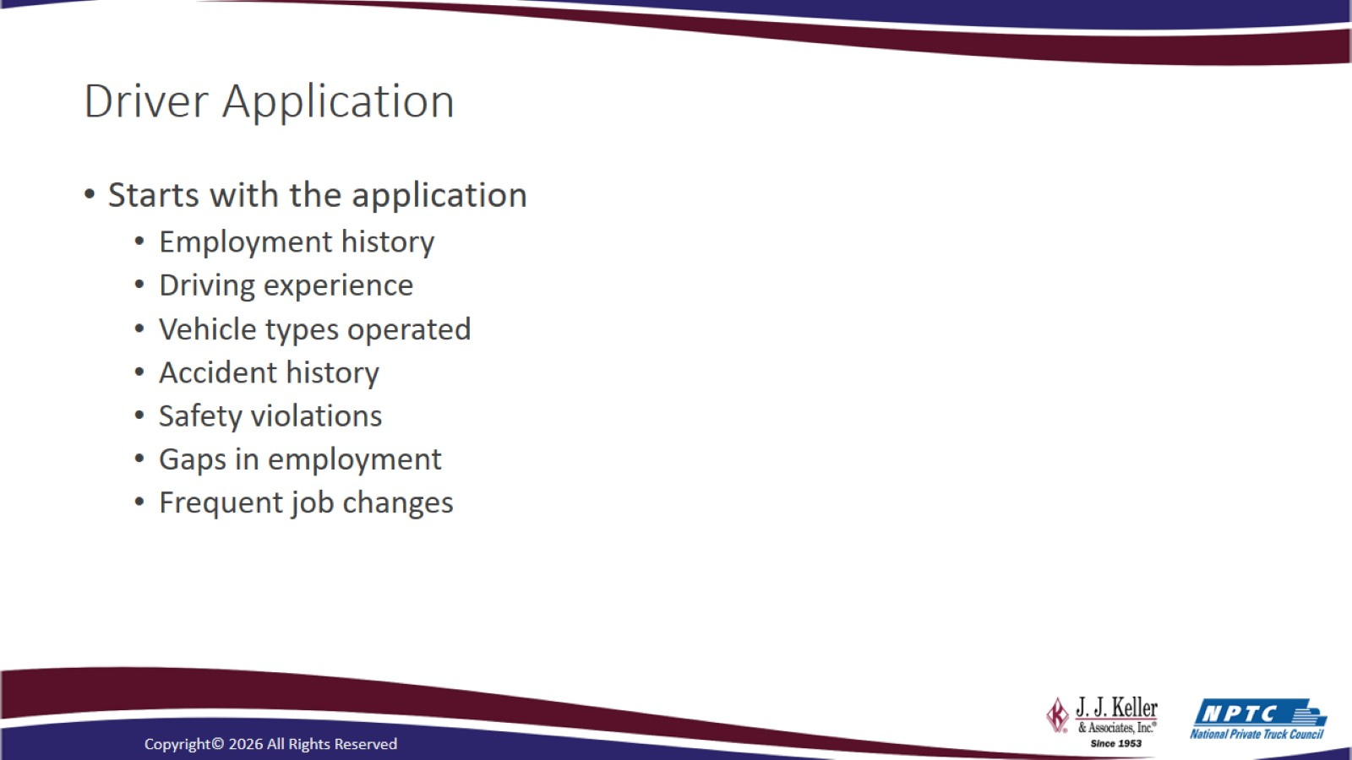
Driver Application

Slide 9
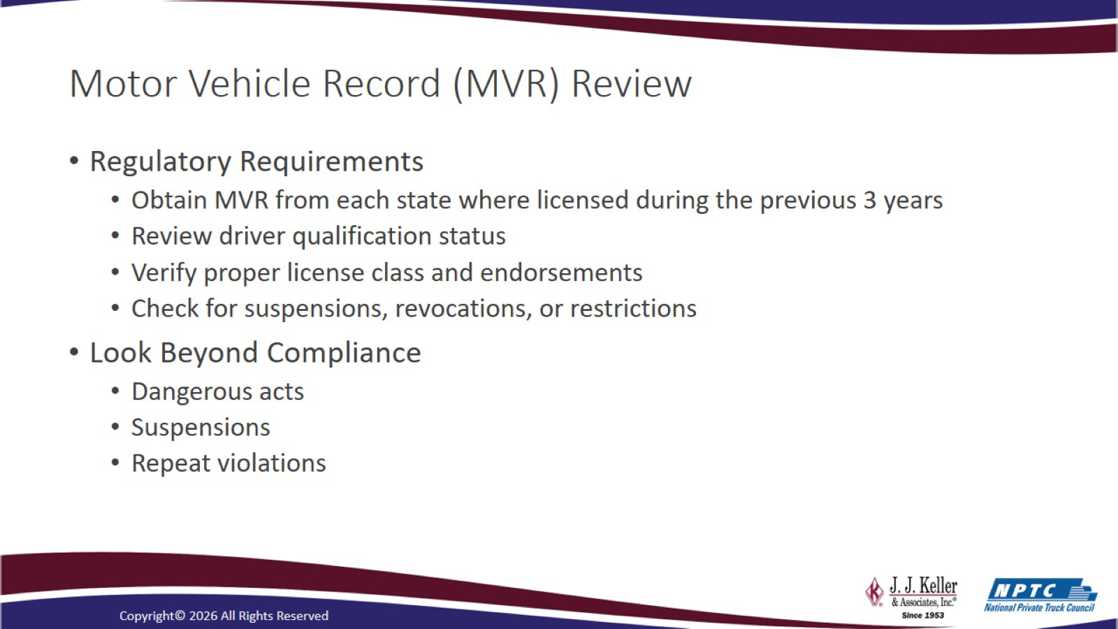
Motor Vehicle Record (MVR) Review

Slide 10
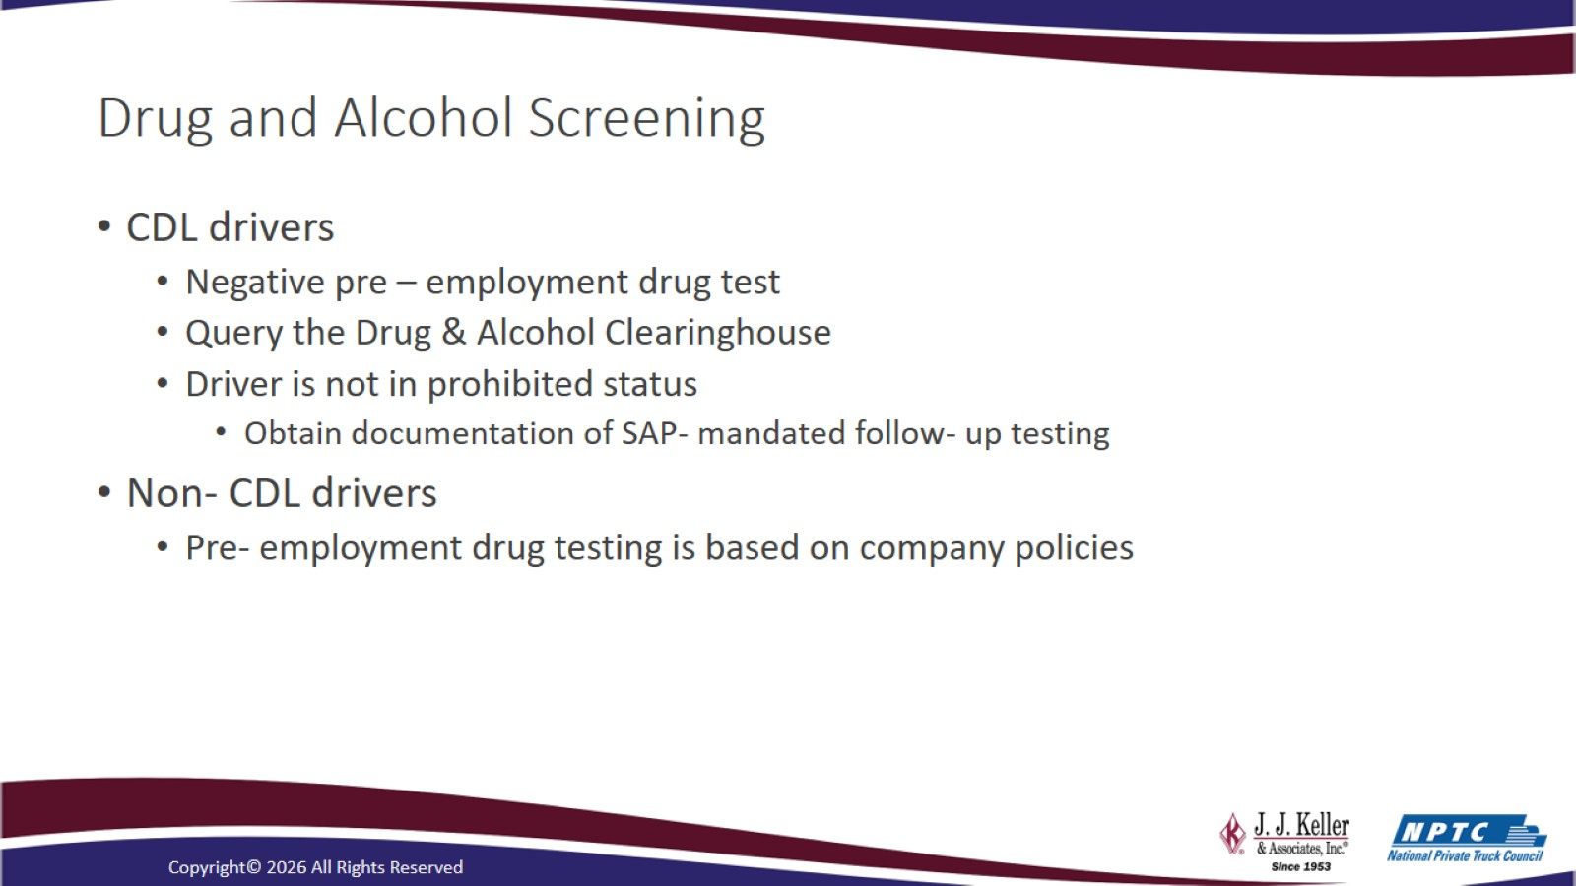
Drug and Alcohol Screening

Slide 11
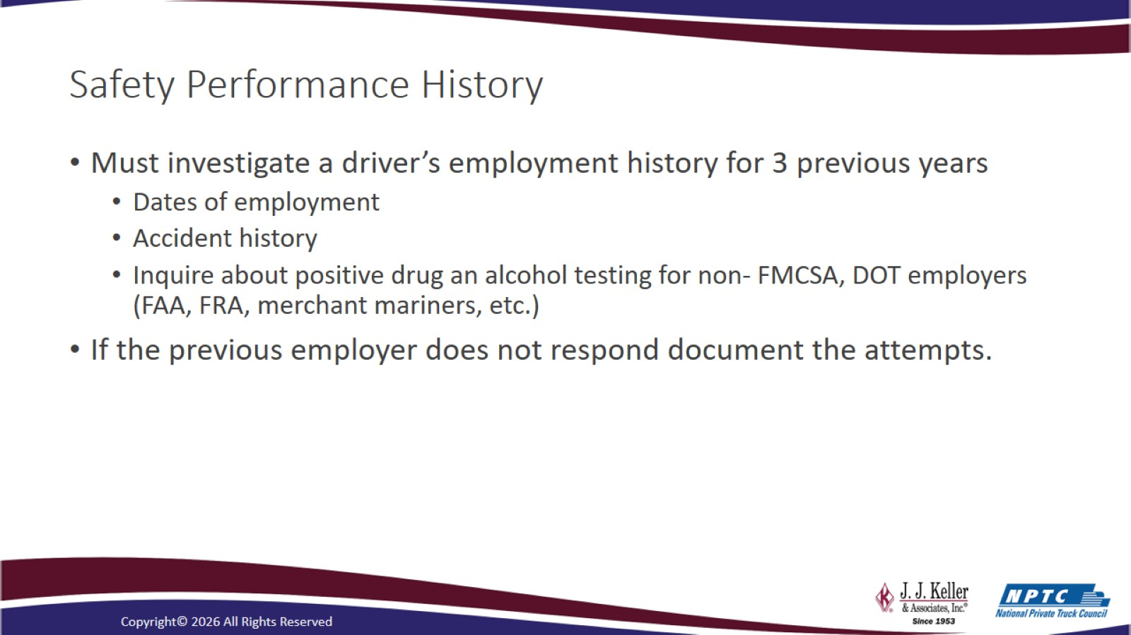
Safety Performance History

Slide 12
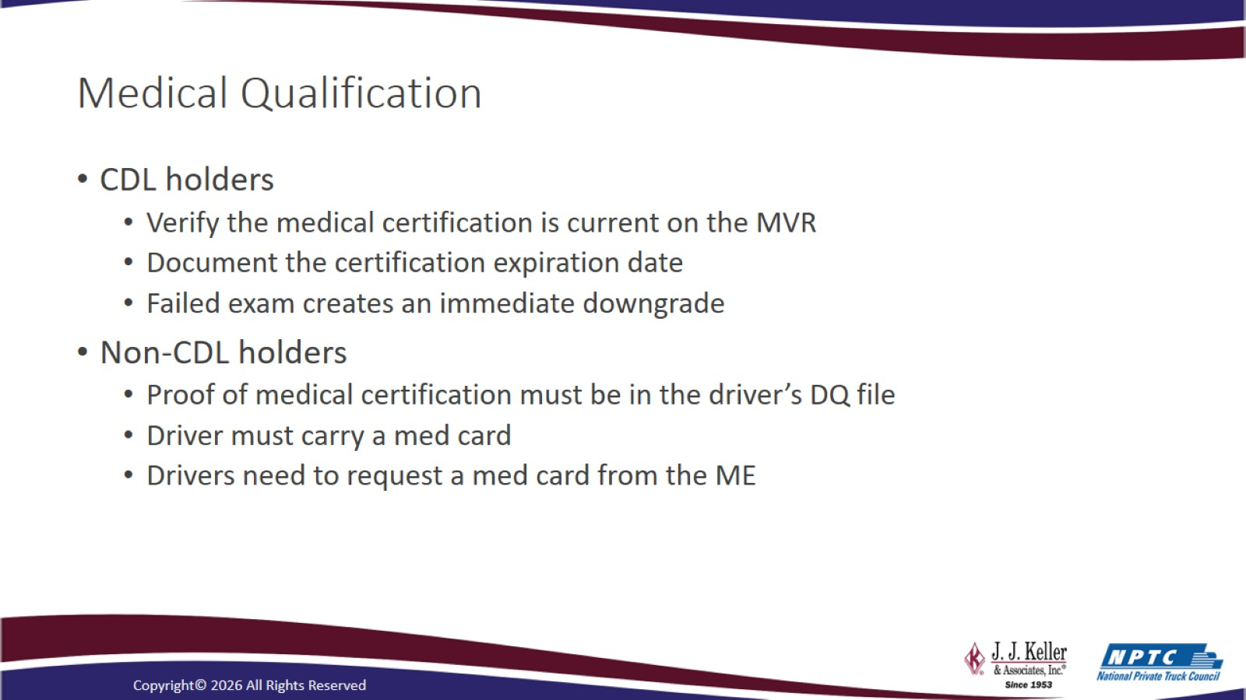
Medical Qualification

Slide 13
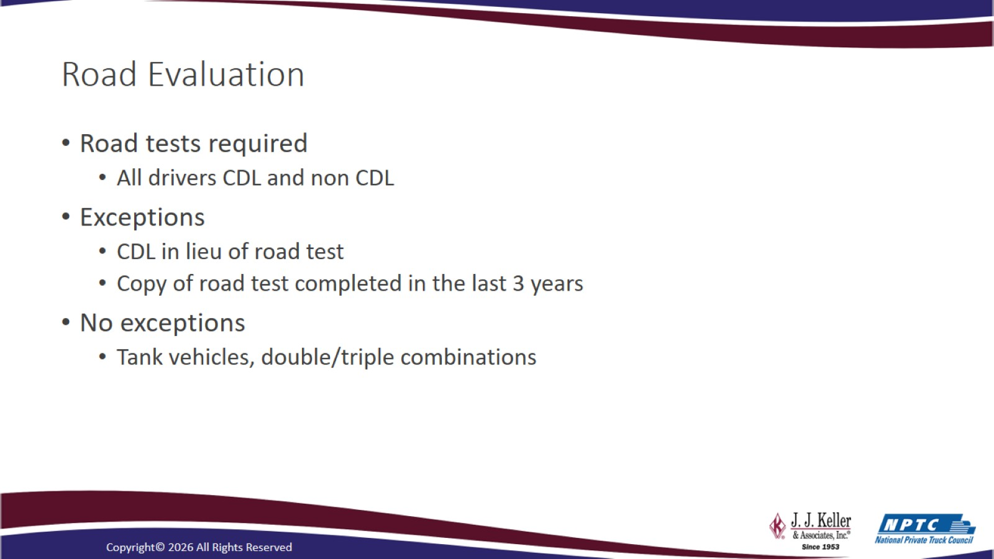
Road Evaluation

Slide 14
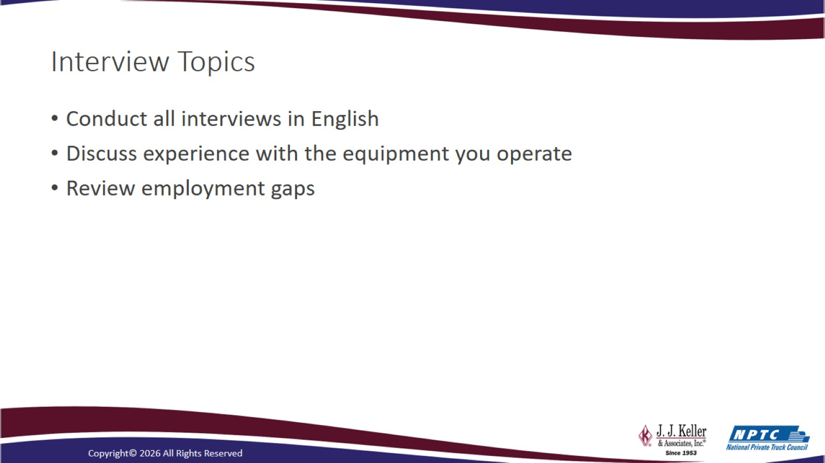
Interview Topics

Slide 15
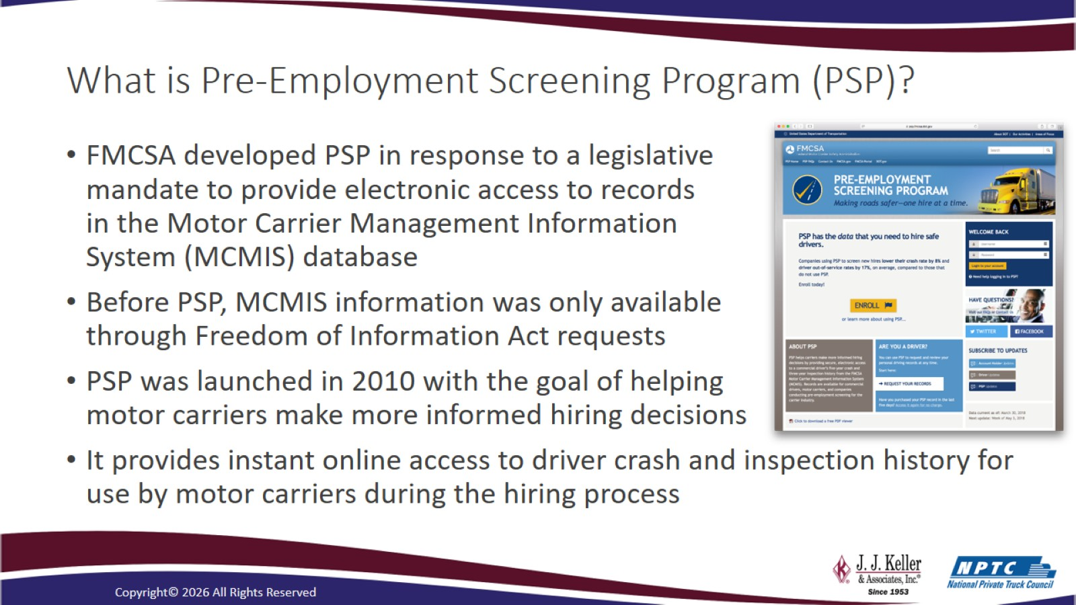
What is Pre-Employment Screening Program (PSP)?

Slide 16
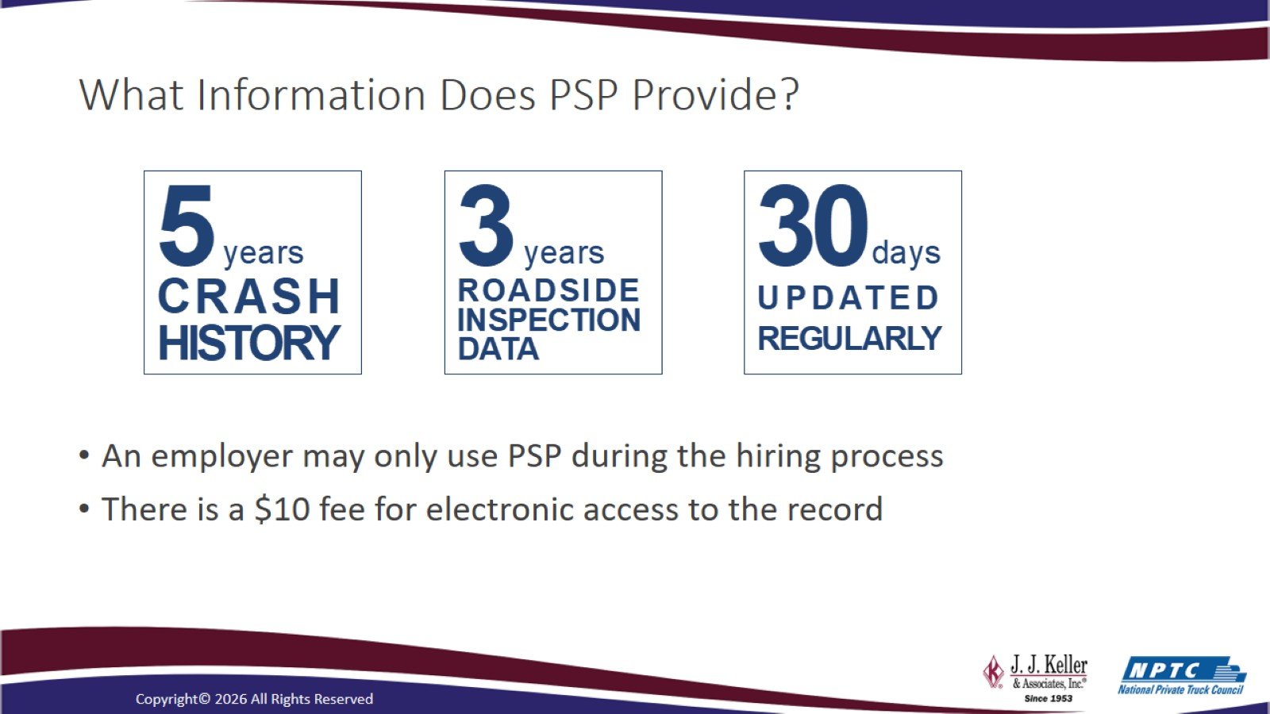
What Information Does PSP Provide?

Slide 17
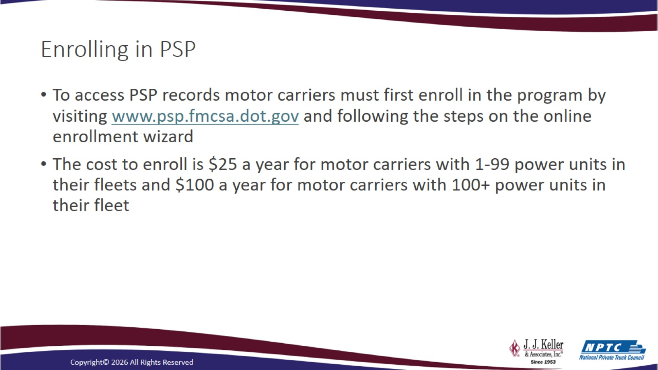
Enrolling in PSP

Slide 18
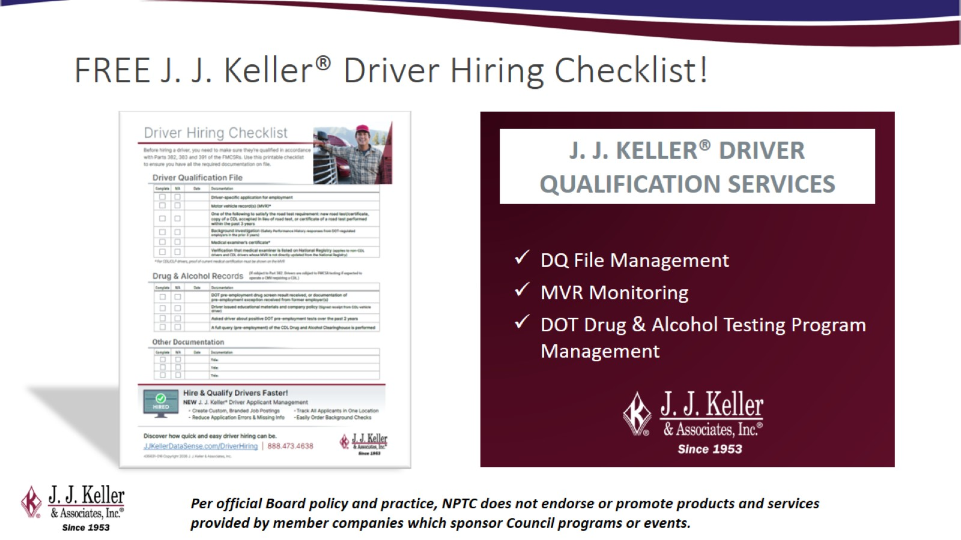
FREE J. J. Keller® Driver Hiring Checklist!

Slide 19
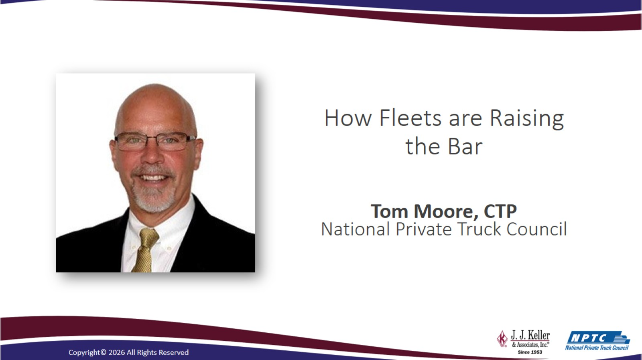
How Fleets are Raising the Bar

Slide 20
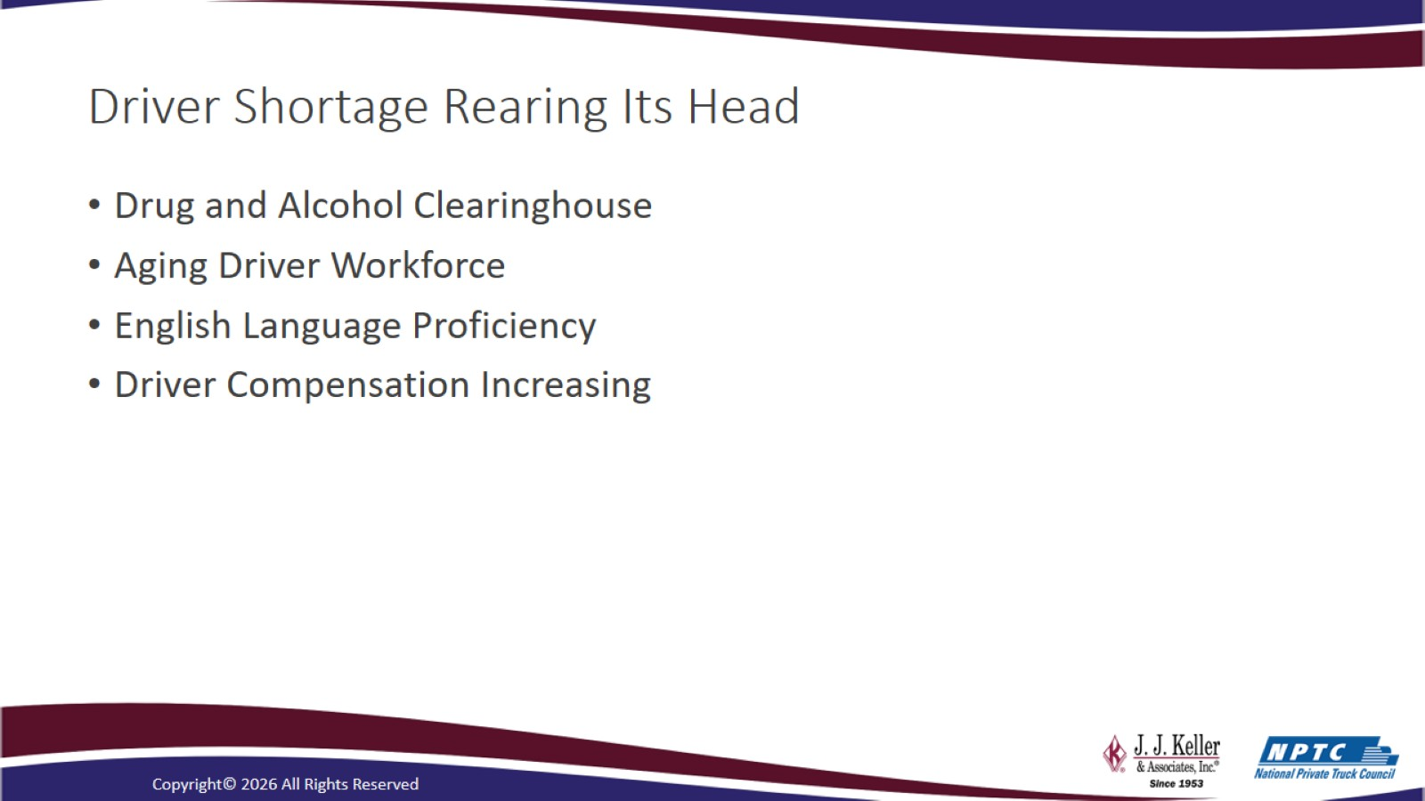
Driver Shortage Rearing Its Head

Slide 21
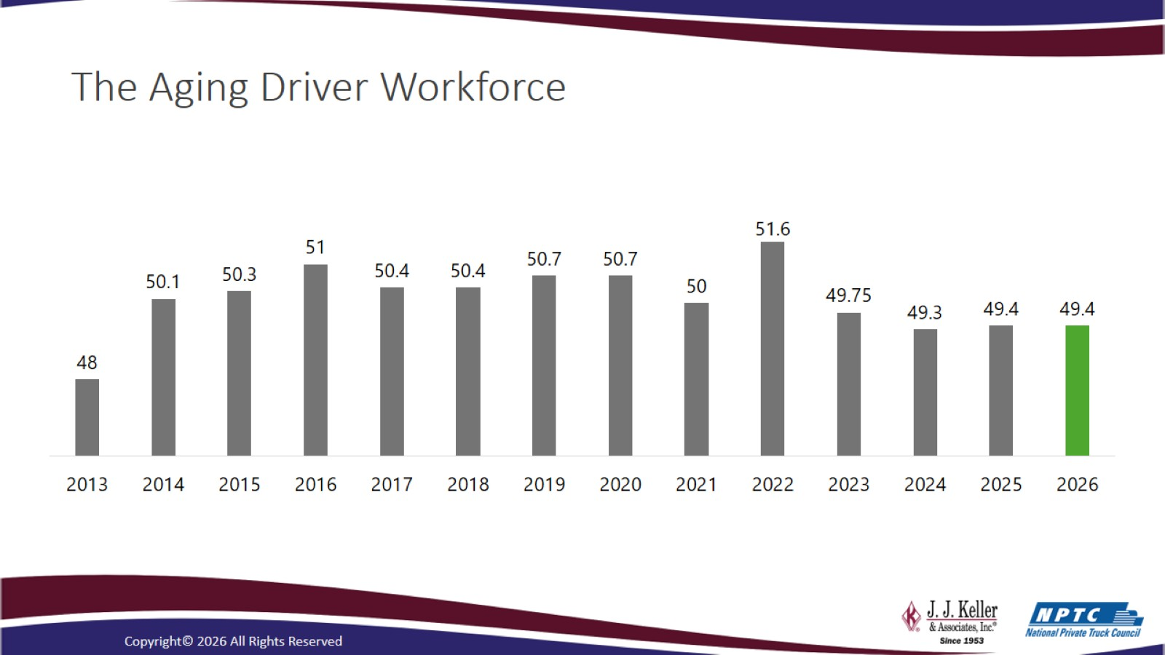
The Aging Driver Workforce

Slide 22
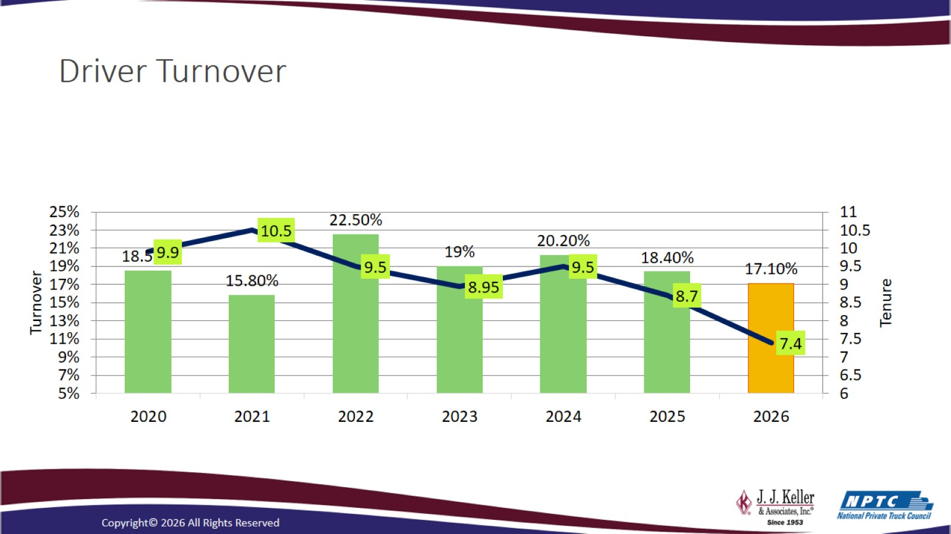
Driver Turnover

Slide 23
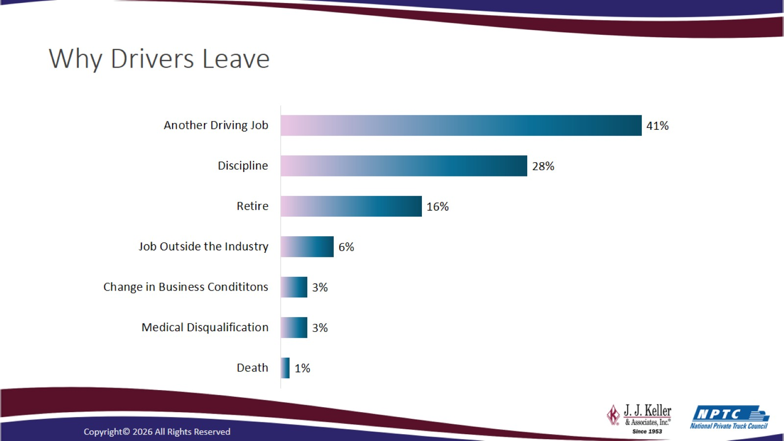
Why Drivers Leave

Slide 24
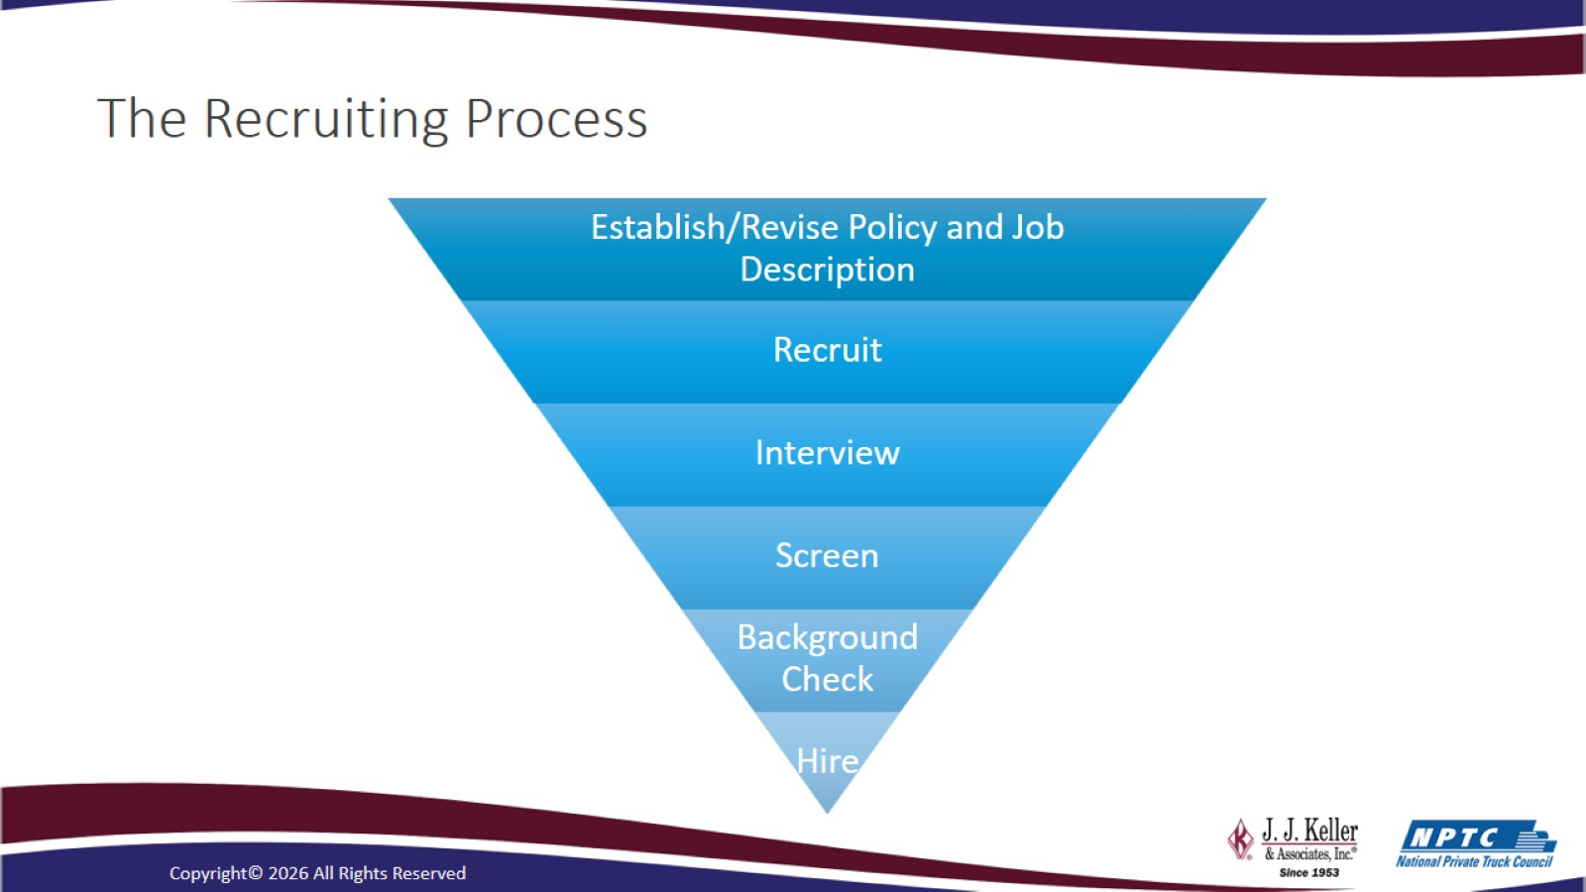
The Recruiting Process

Slide 25
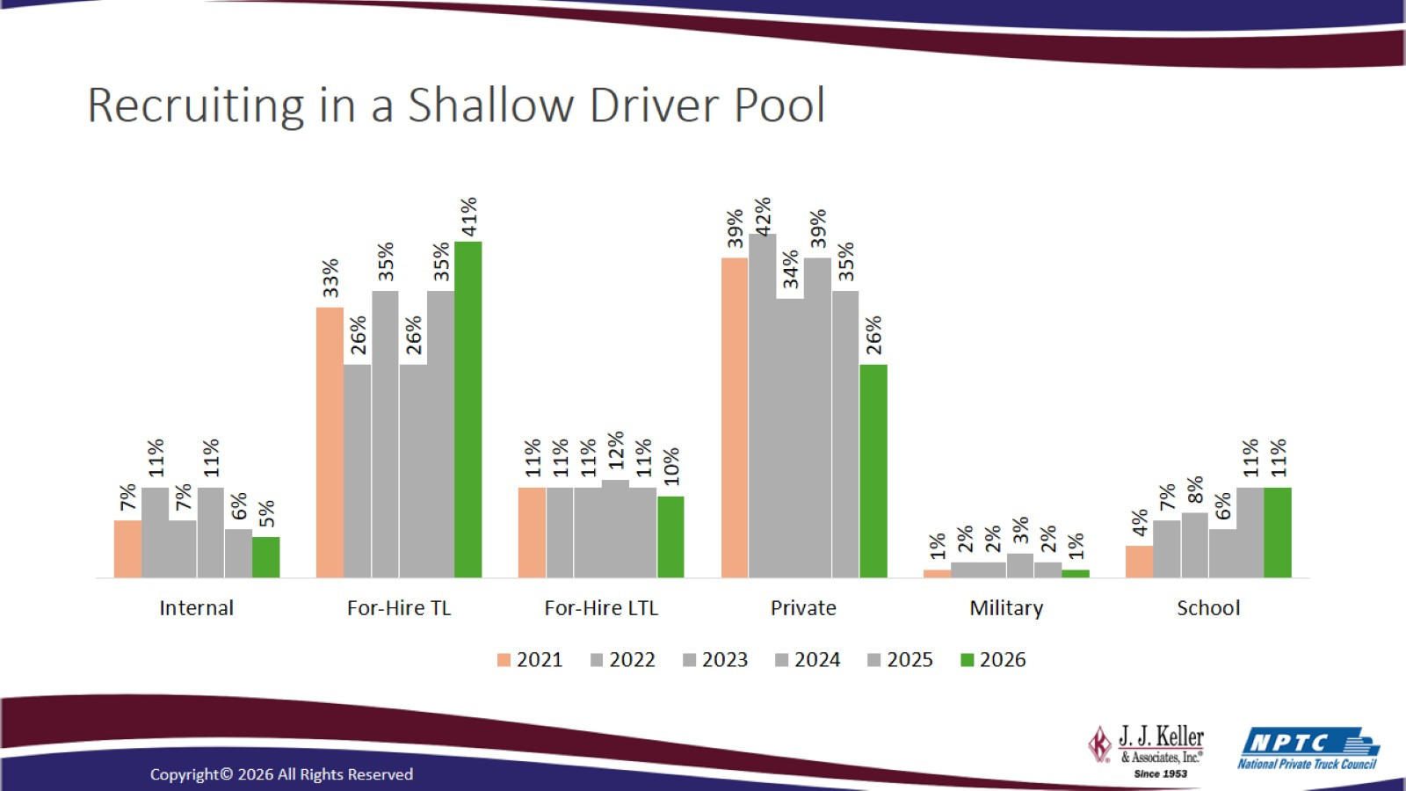
Recruiting in a Shallow Driver Pool

Slide 26
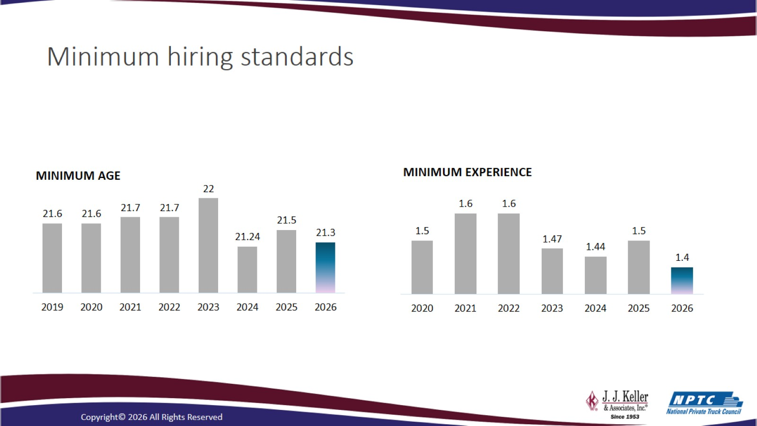
Minimum hiring standards

Slide 27
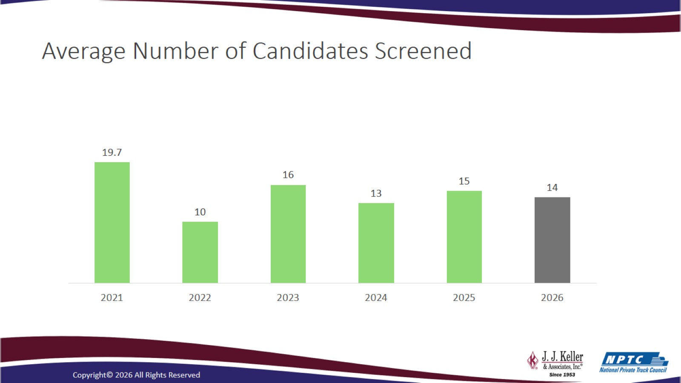
Average Number of Candidates Screened

Slide 28
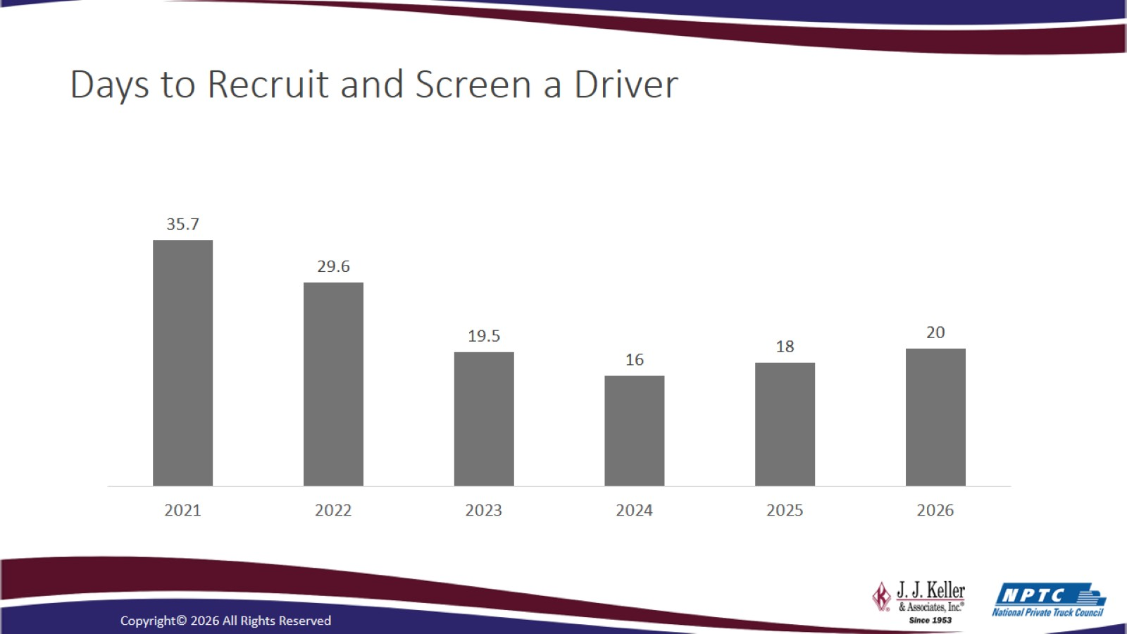
Days to Recruit and Screen a Driver

Slide 29
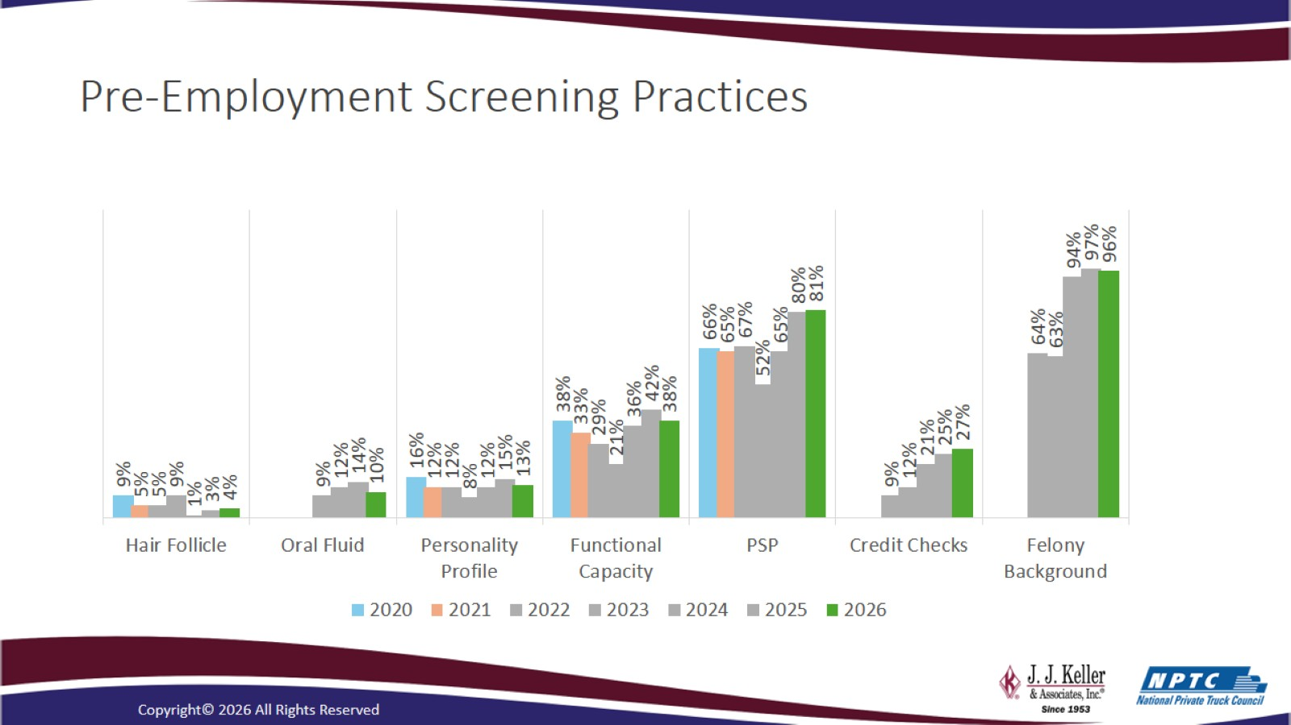
Pre-Employment Screening Practices

Slide 30
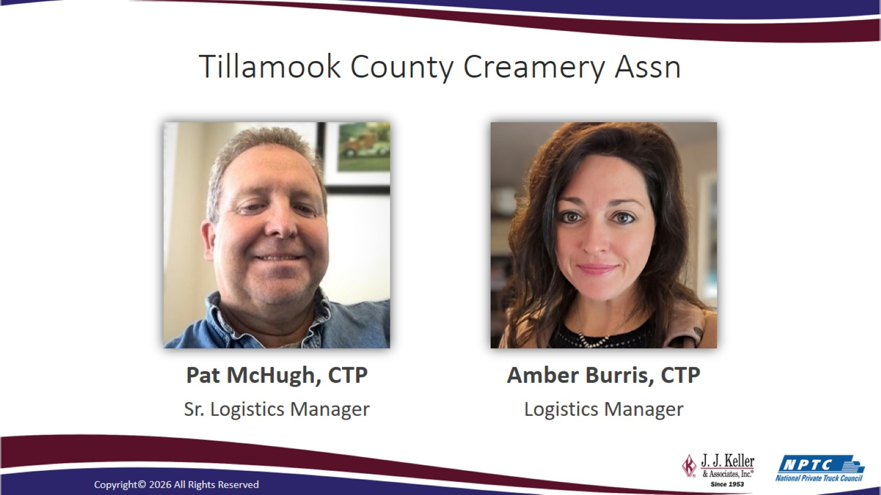
Tillamook County Creamery Assn

Slide 31
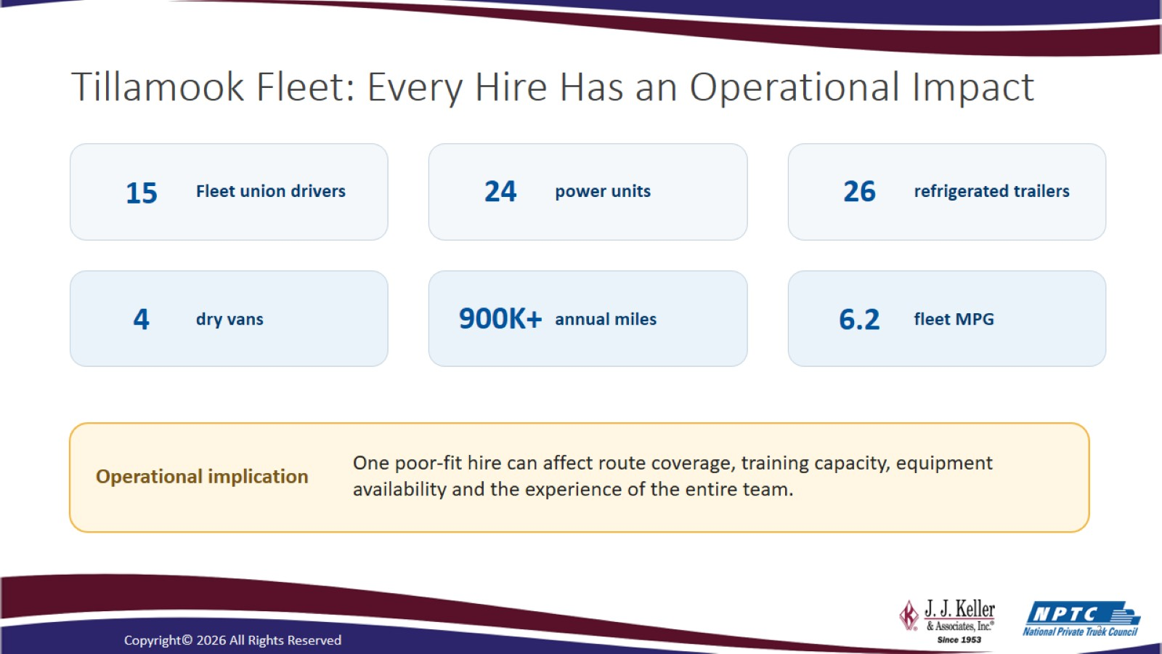
Tillamook Fleet: Every Hire Has an Operational Impact

Slide 32
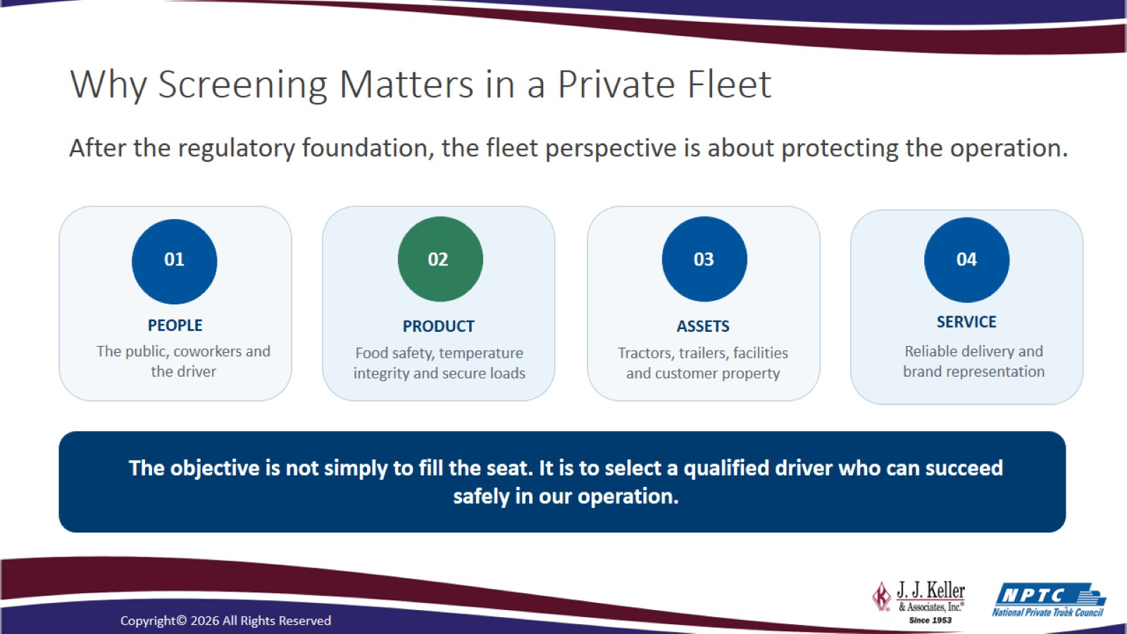
Why Screening Matters in a Private Fleet

Slide 33
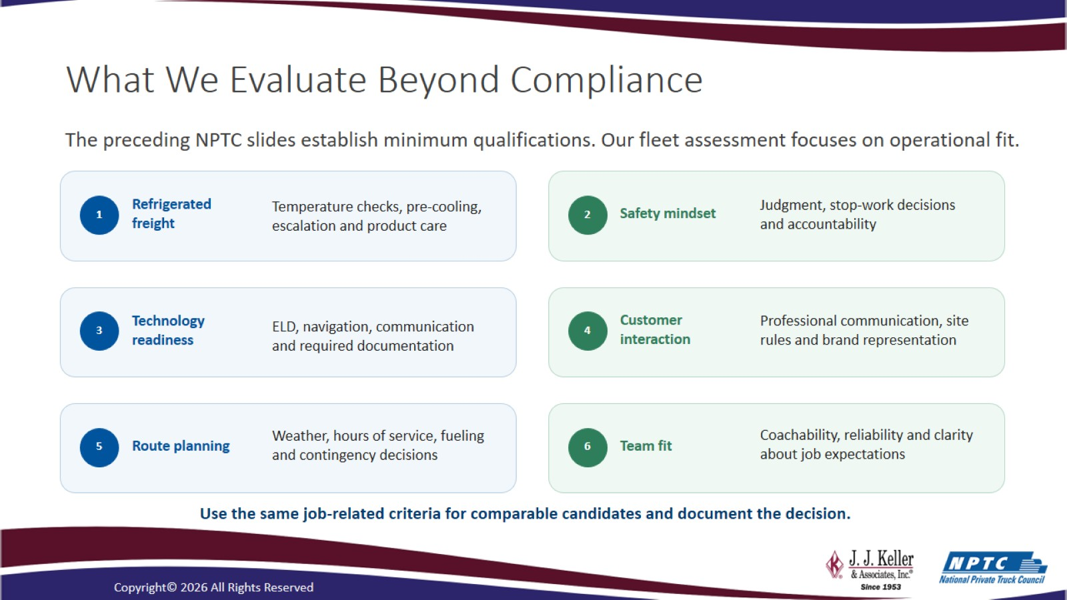
What We Evaluate Beyond Compliance

Slide 34
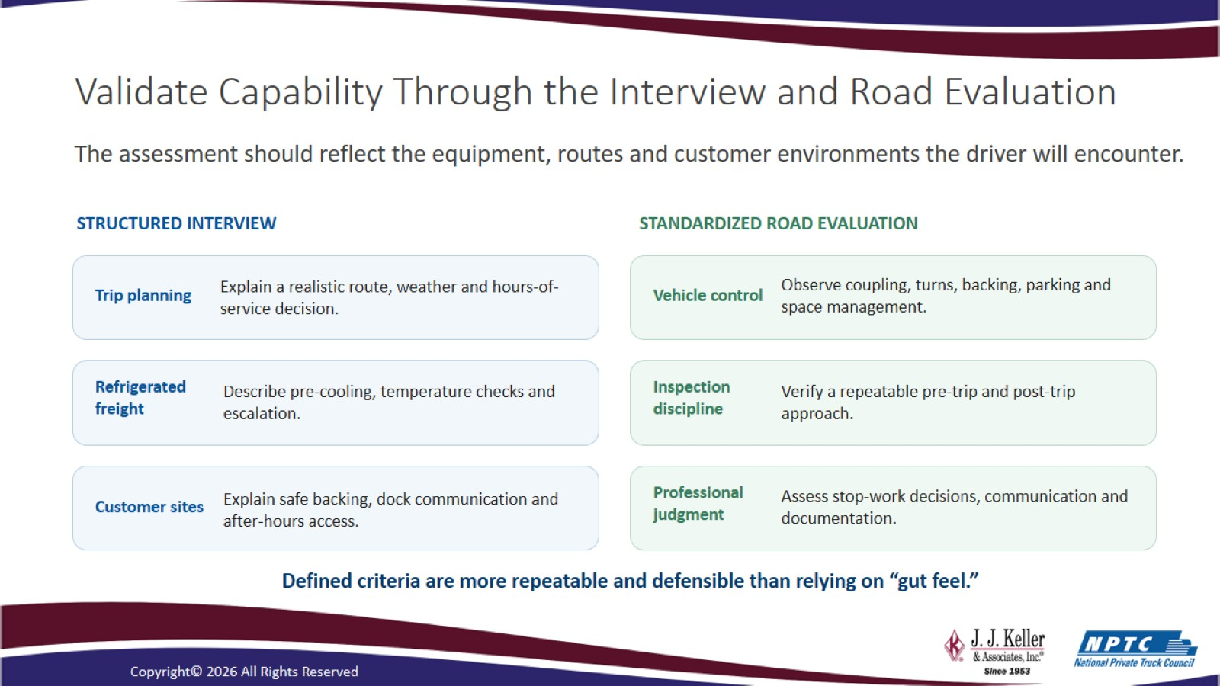
Validate Capability Through the Interview and Road Evaluation

Slide 35
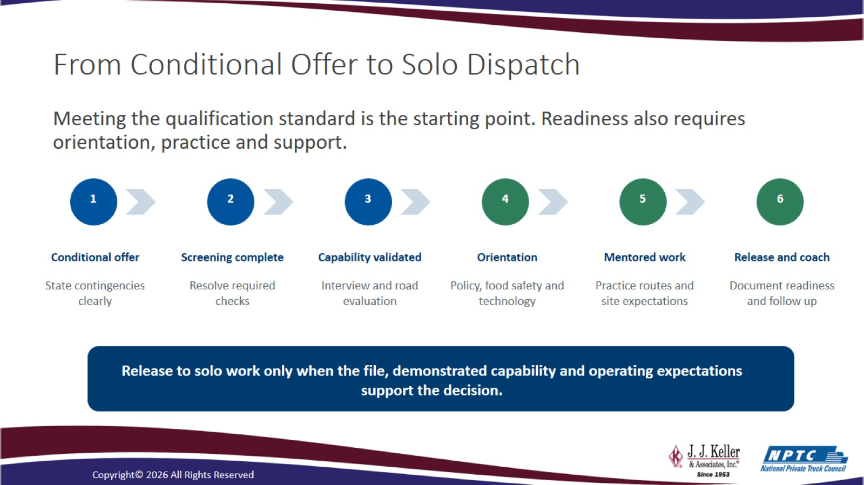
From Conditional Offer to Solo Dispatch

Slide 36
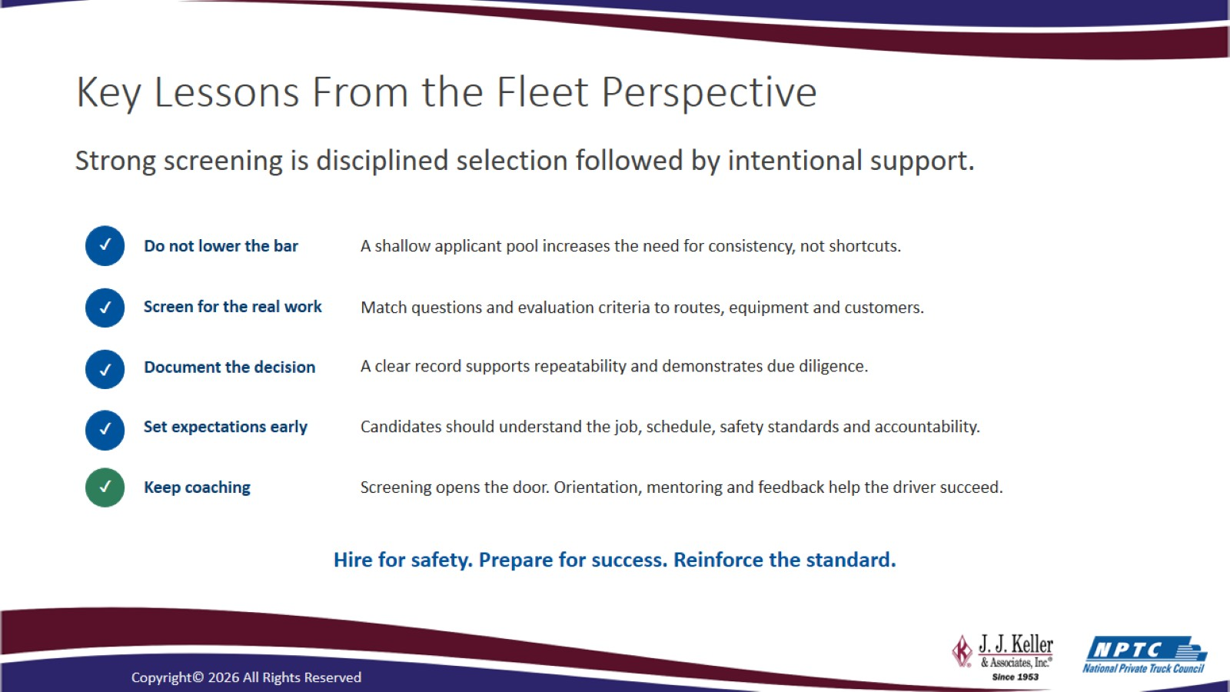
Key Lessons From the Fleet Perspective

Slide 37

Questions and Answers

Slide 38
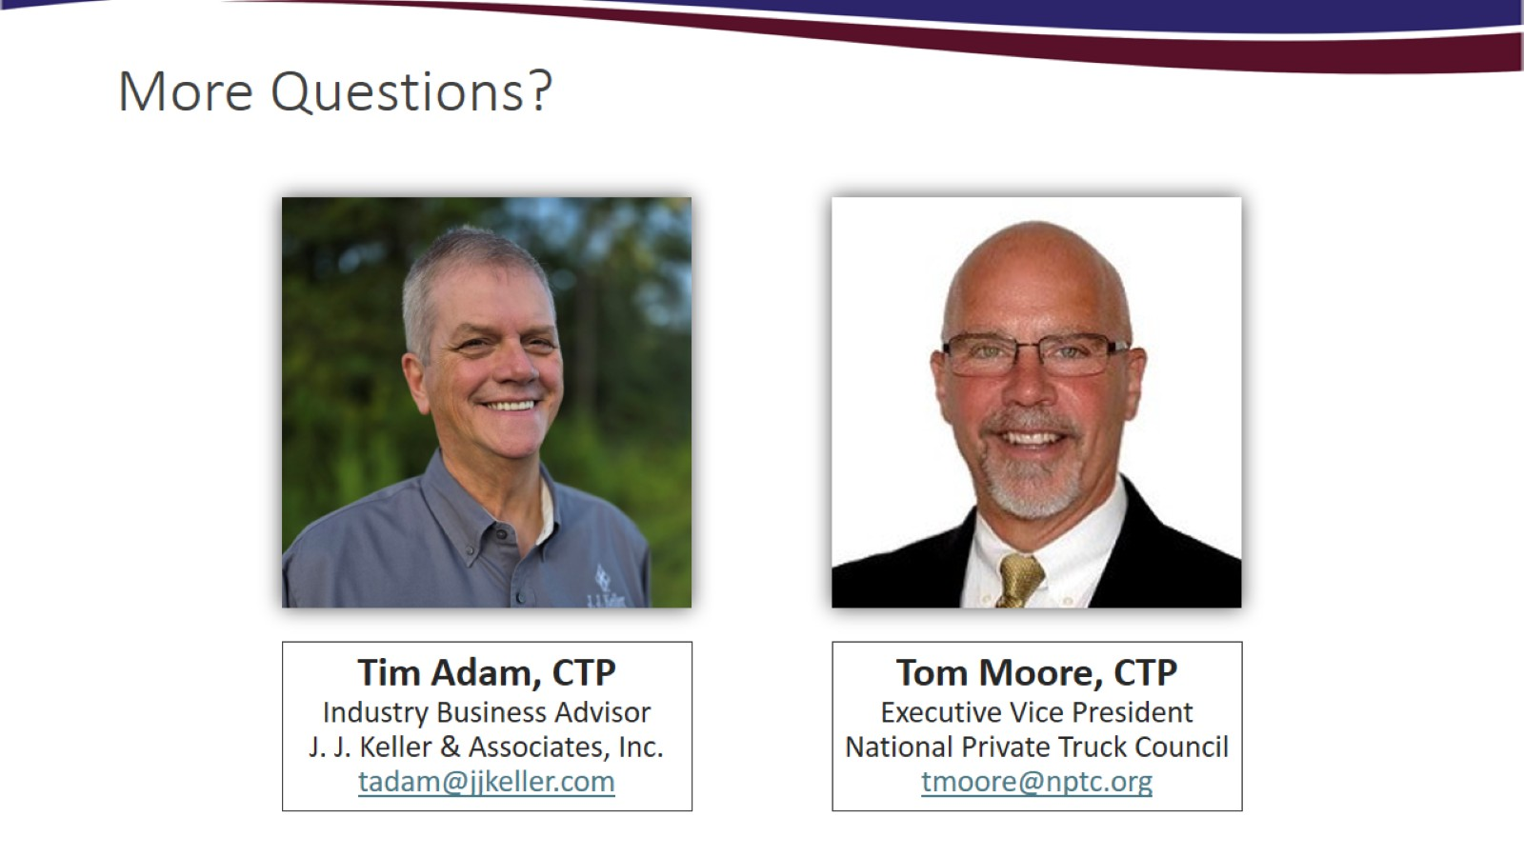
More Questions?

Slide 39
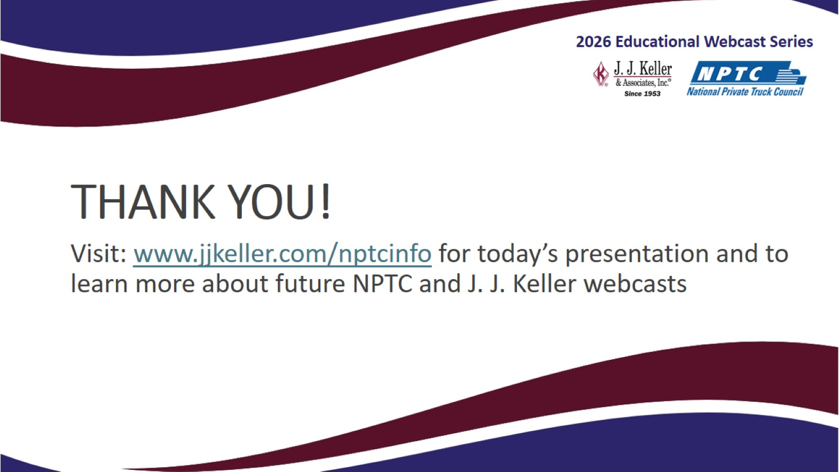
THANK YOU!

Slide 40
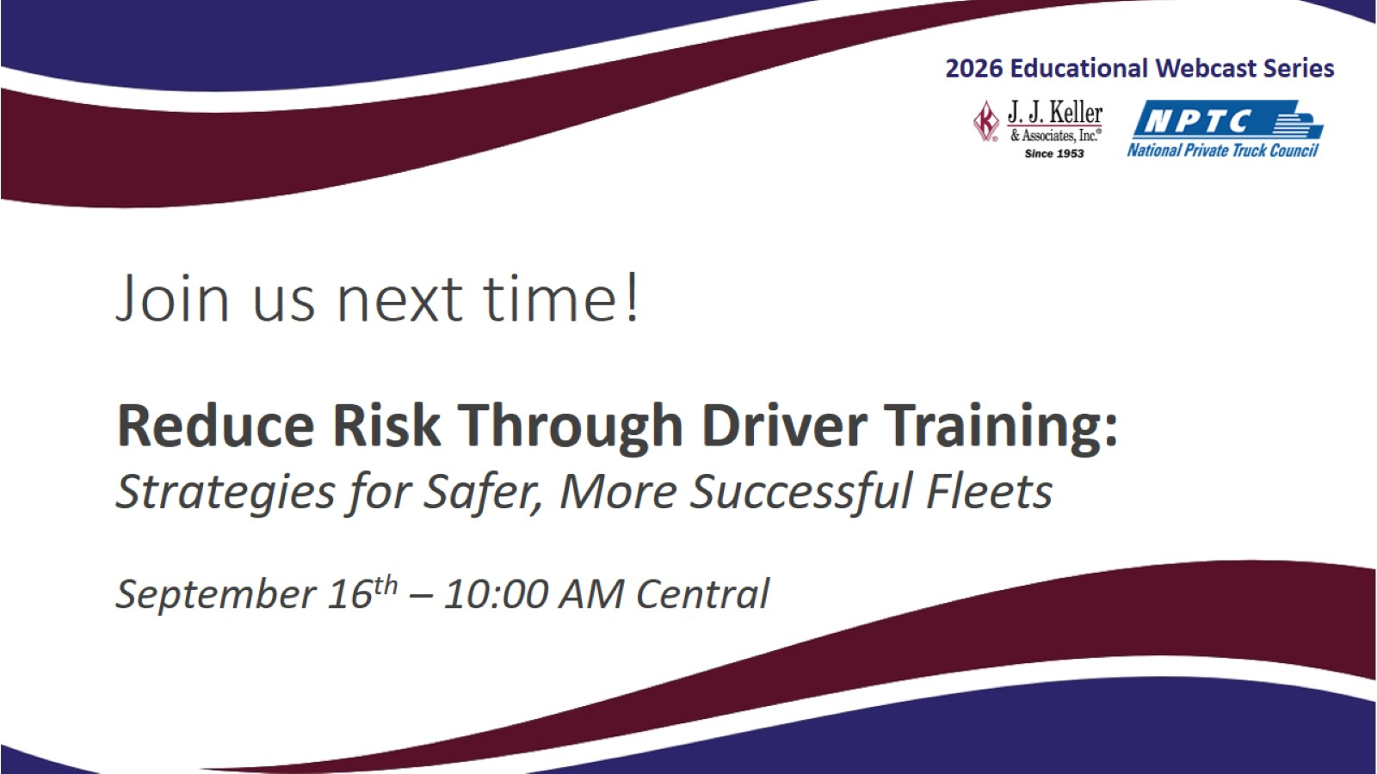
Join us next time!

Slide 41
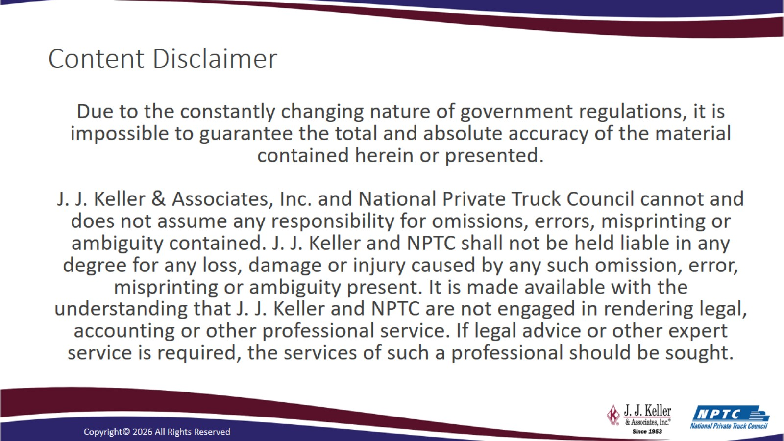
Content Disclaimer

