Slide 1
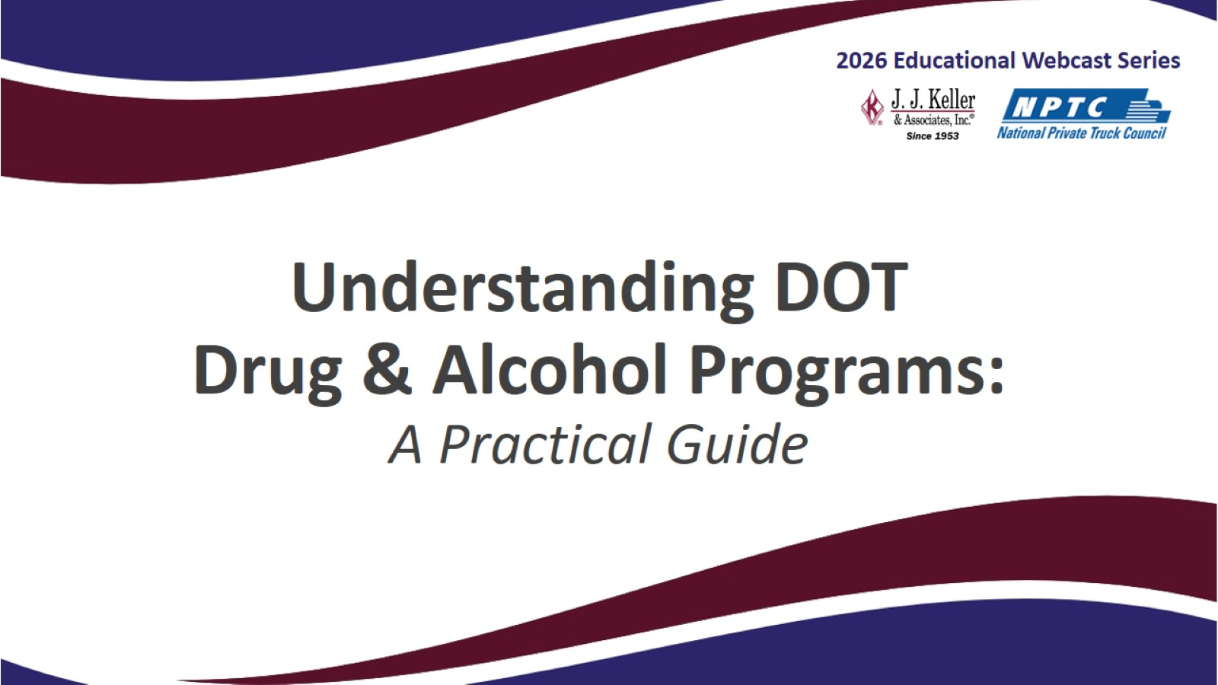
Understanding DOT
Drug & Alcohol Programs:
A Practical Guide

Slide 2
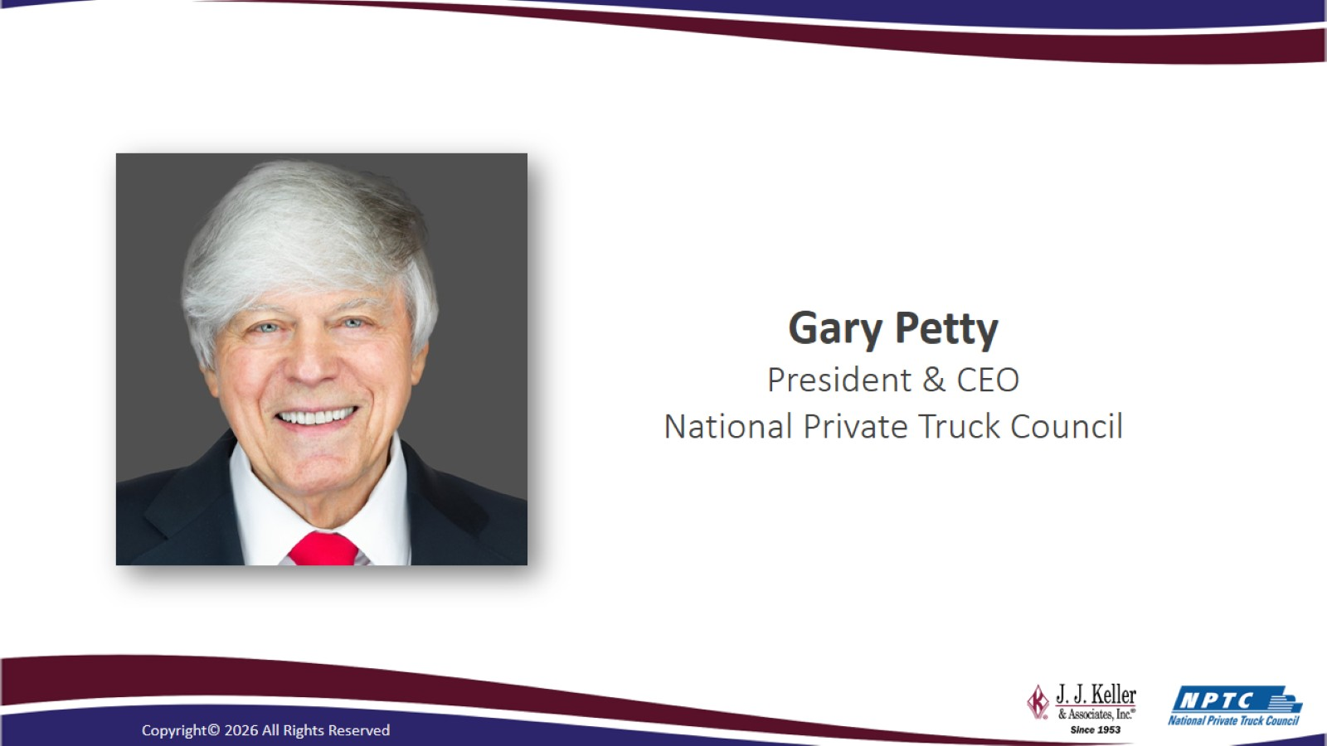

Slide 3


Slide 4

Thank You for Joining Us!
This webcast will cover …
  A regulatory overview
  Best practices in compliance
  A case study in implementation
  Question & Answer session
You will be muted during the event.
Please use the Q&A feature to send in questions. We’ll try to answer them during the Q&A period if they are not covered in the presentation.
The slides and recording will be posted within 7 days at: www.jjkeller.com/nptcinfo

Slide 5
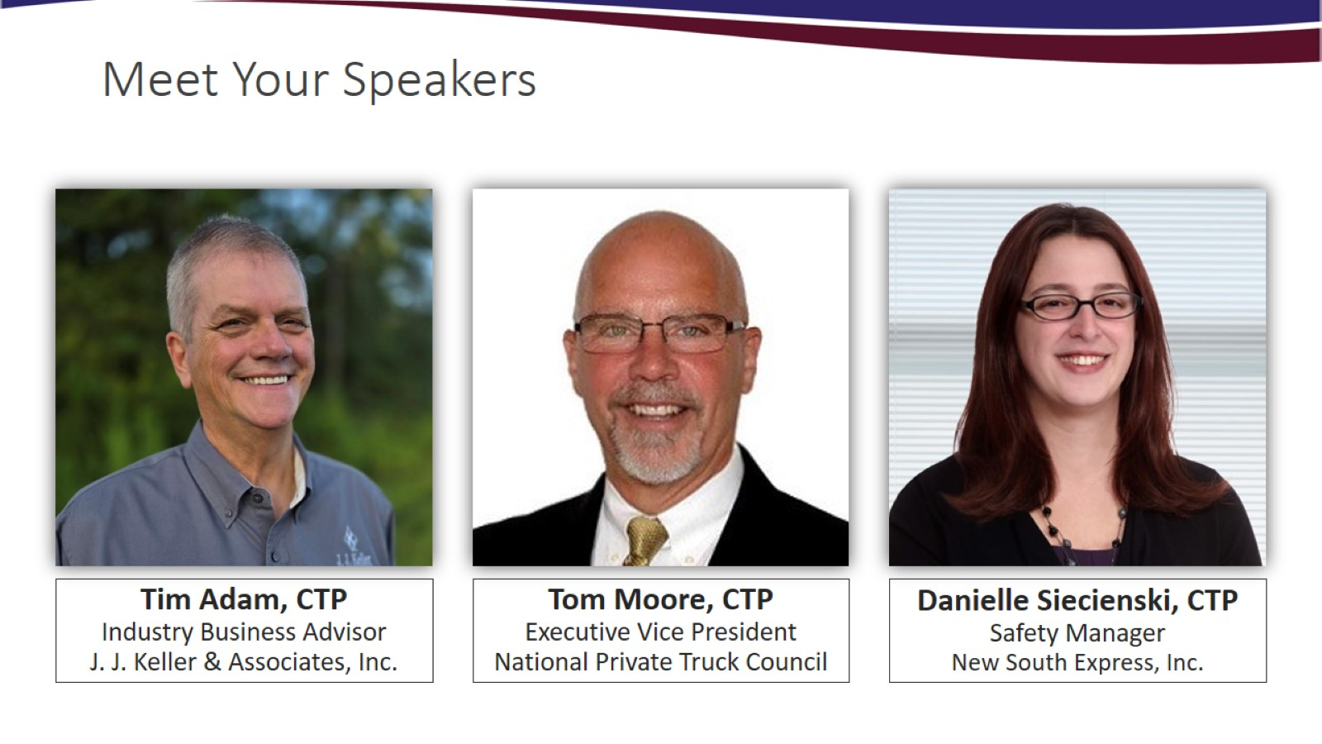
Meet Your Speakers

Slide 6
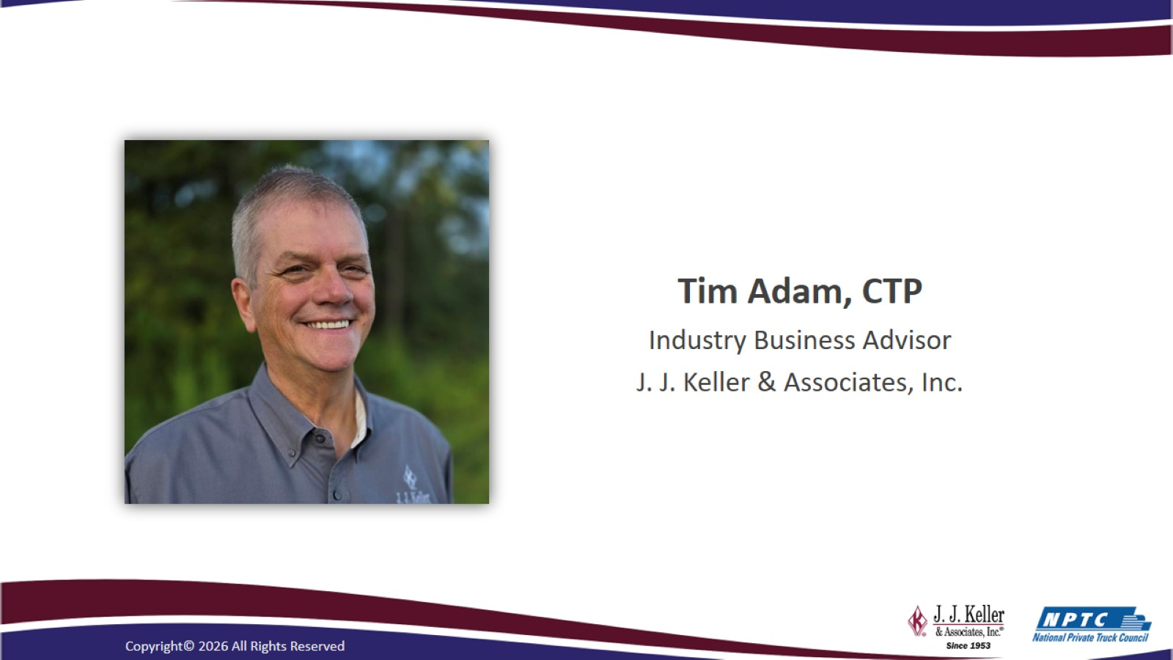

Slide 7
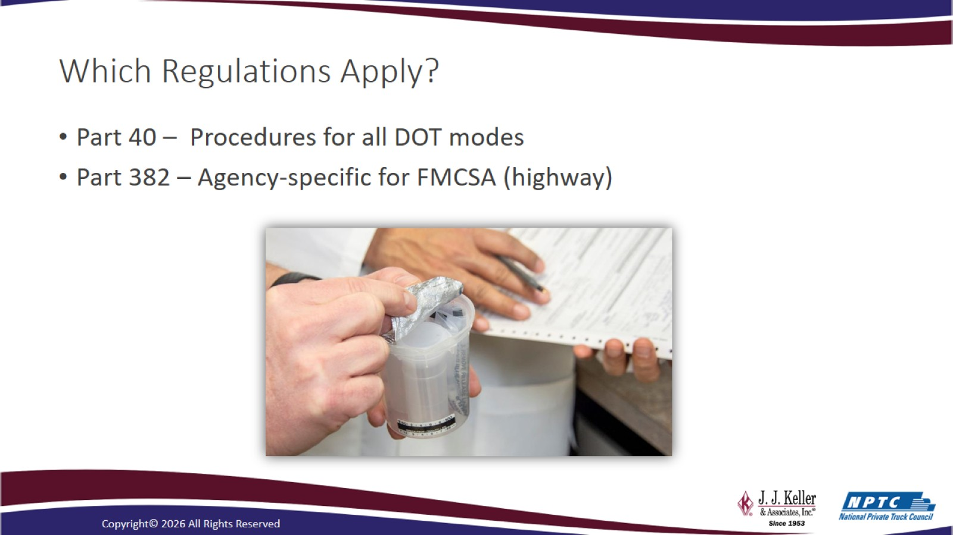
Which Regulations Apply?

Slide 8
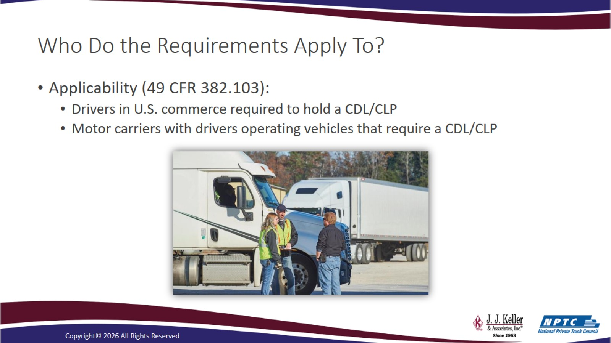
Who Do the Requirements Apply To?

Slide 9
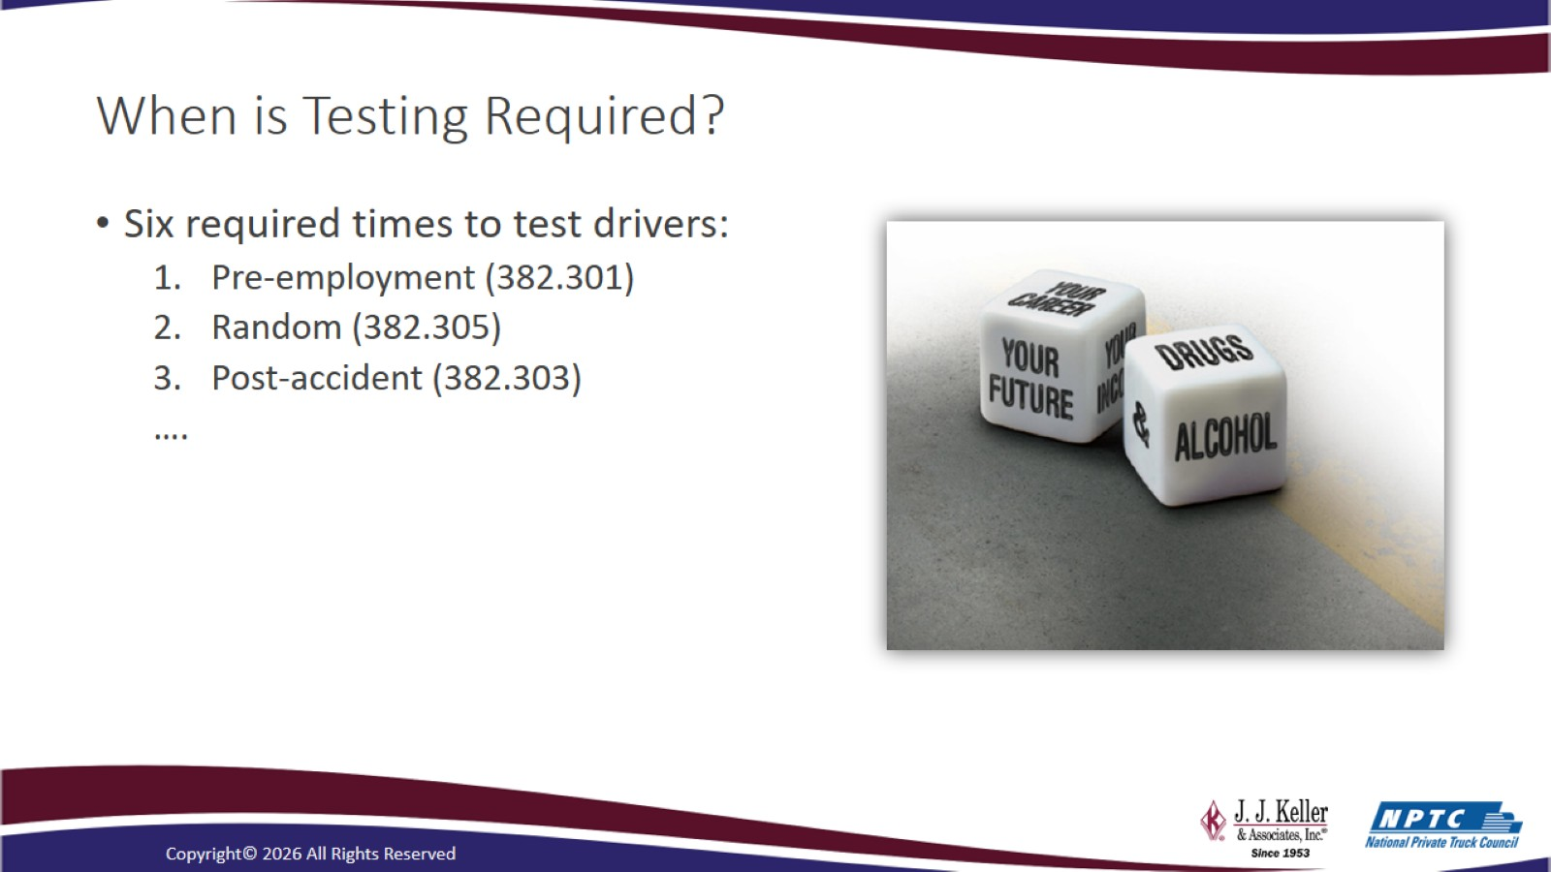
When is Testing Required?

Slide 10
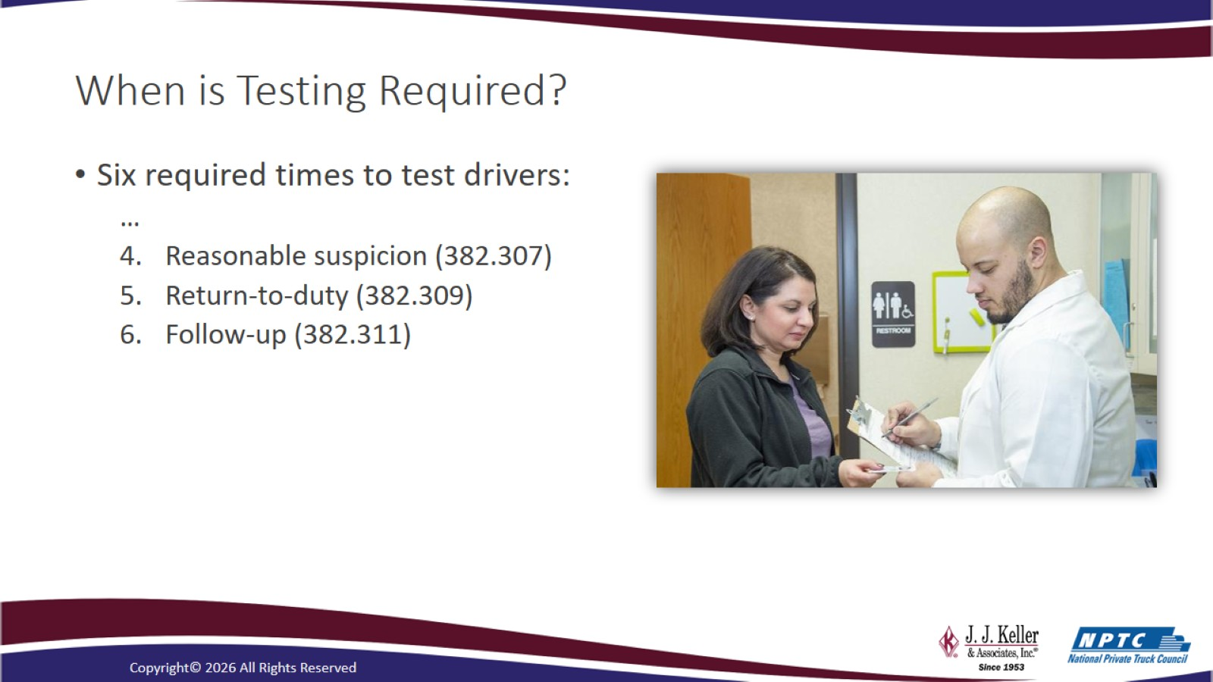
When is Testing Required?

Slide 11
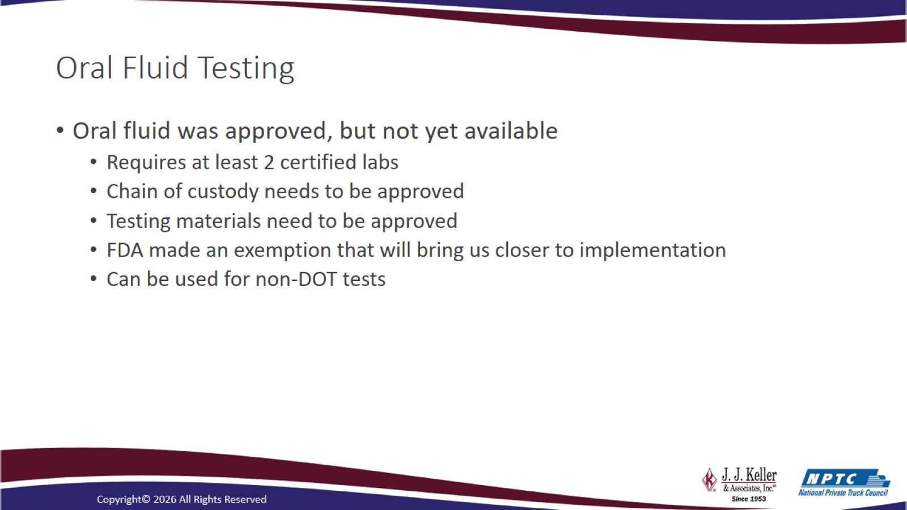
Oral Fluid Testing

Slide 12
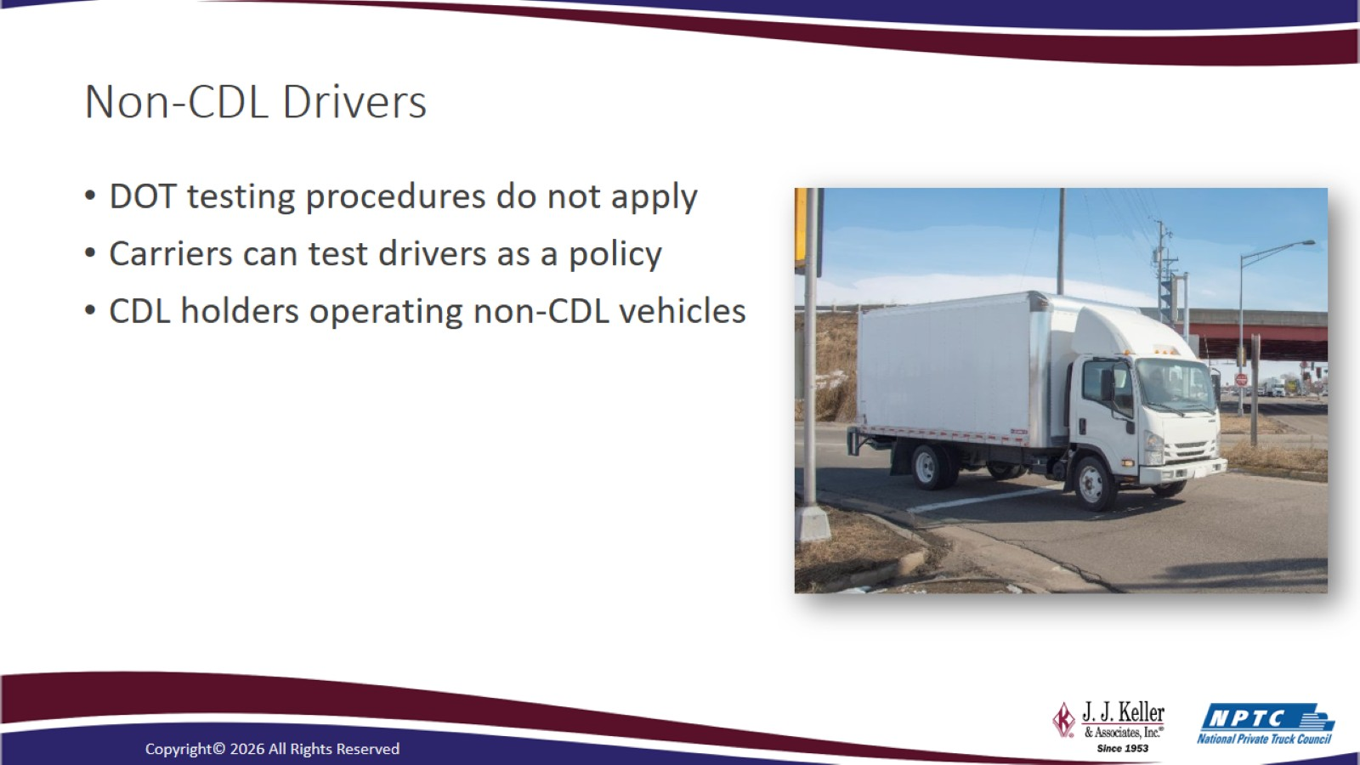
Non-CDL Drivers

Slide 13

Sponsor slide

Slide 14
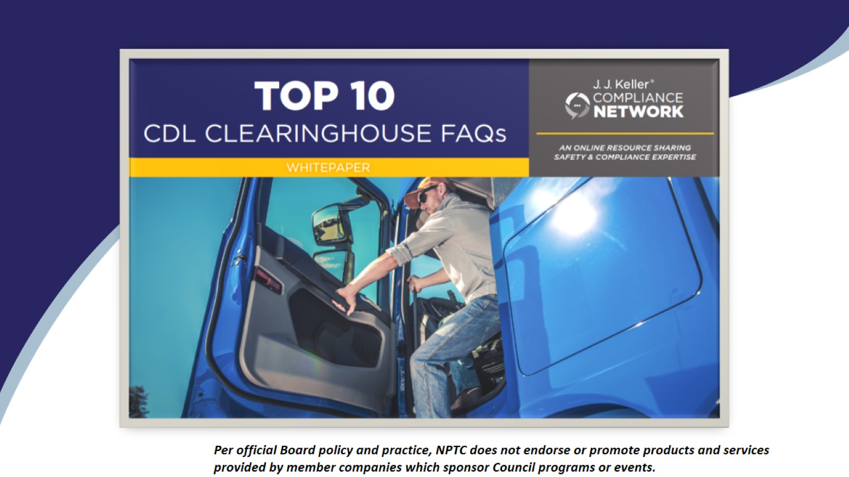

Slide 15
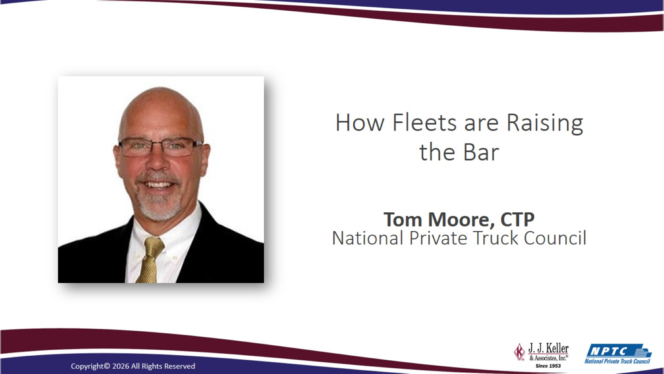
How Fleets are Raising the Bar

Slide 16
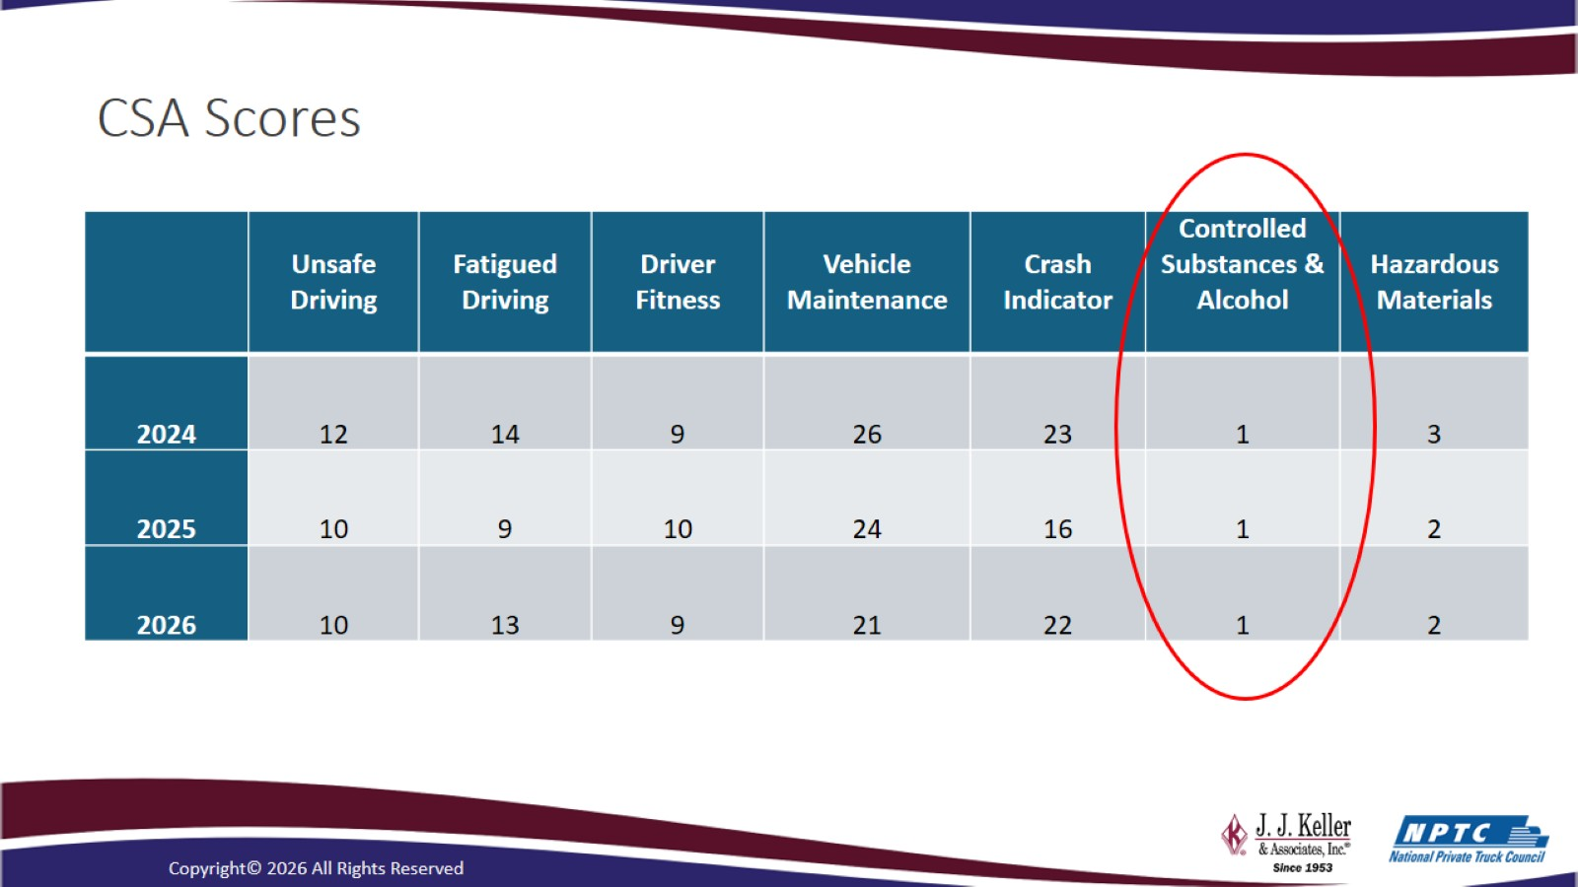
CSA Scores

Slide 17
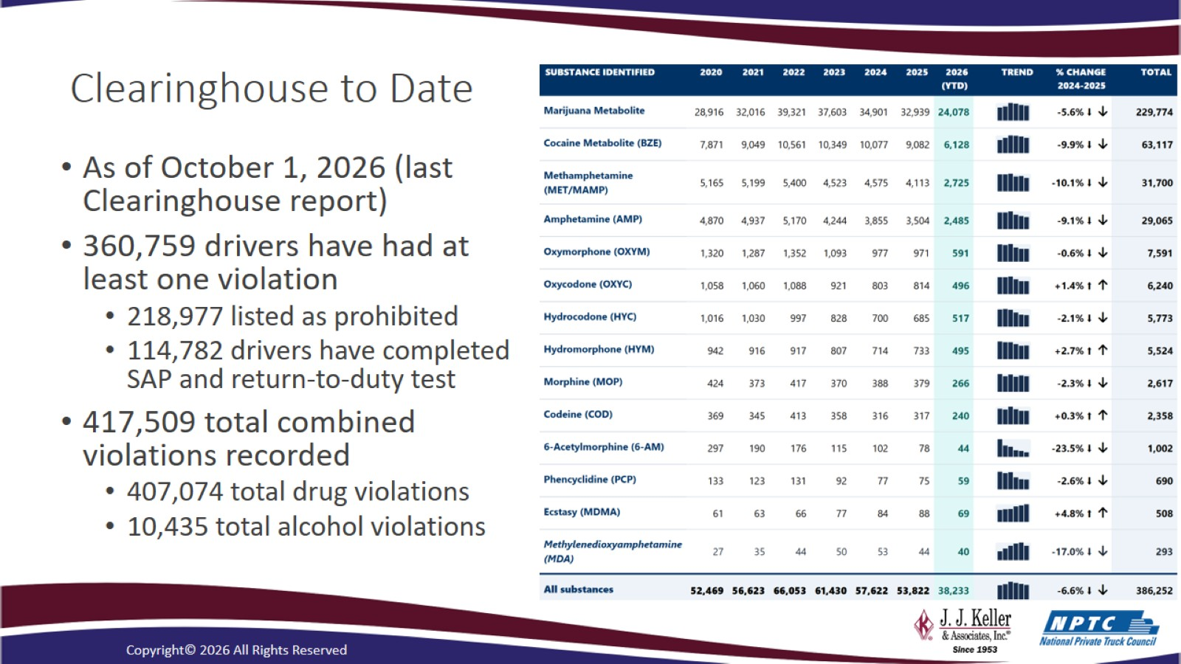
Clearinghouse to Date

Slide 18
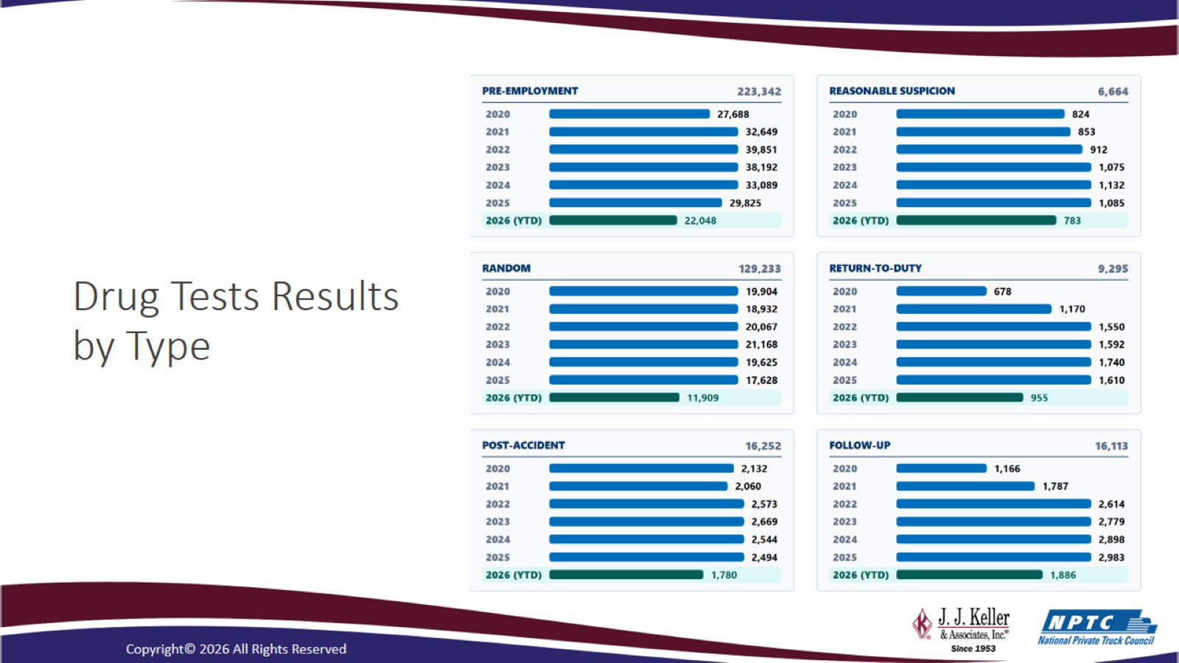
Drug Tests Results by Type
https://clearinghouse.fmcsa.dot.gov/

Slide 19
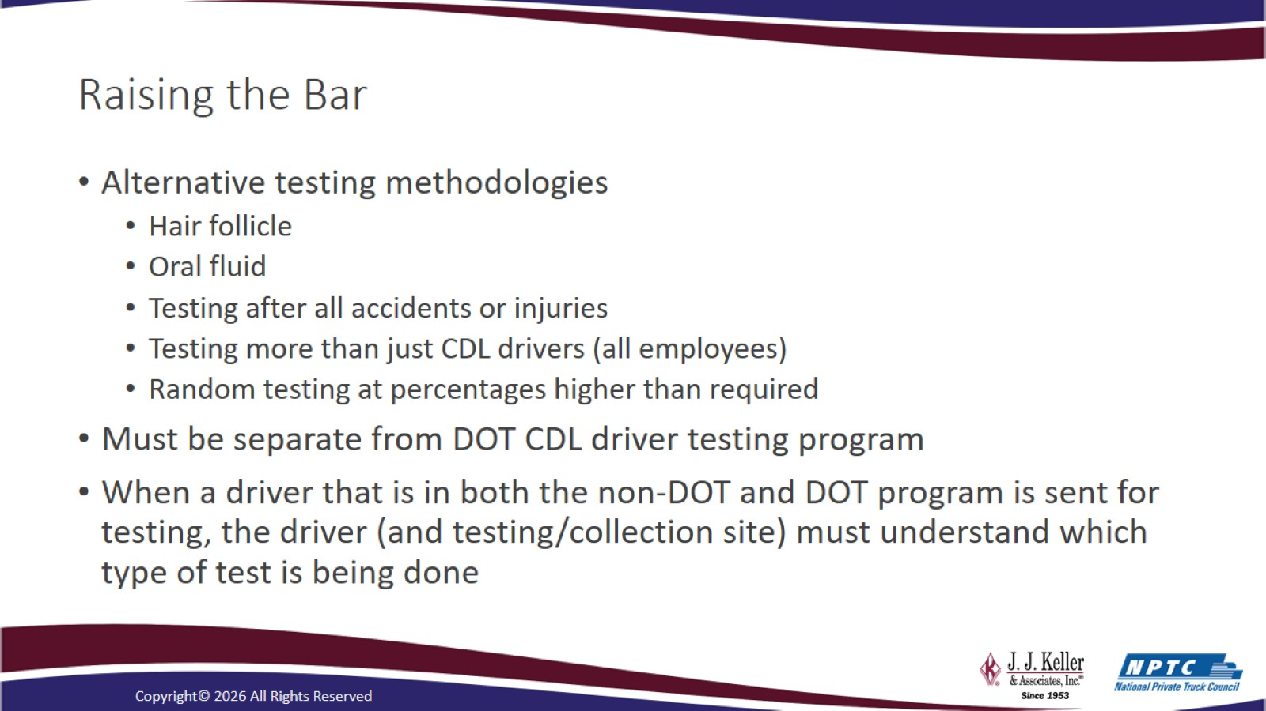
Raising the Bar

Slide 20
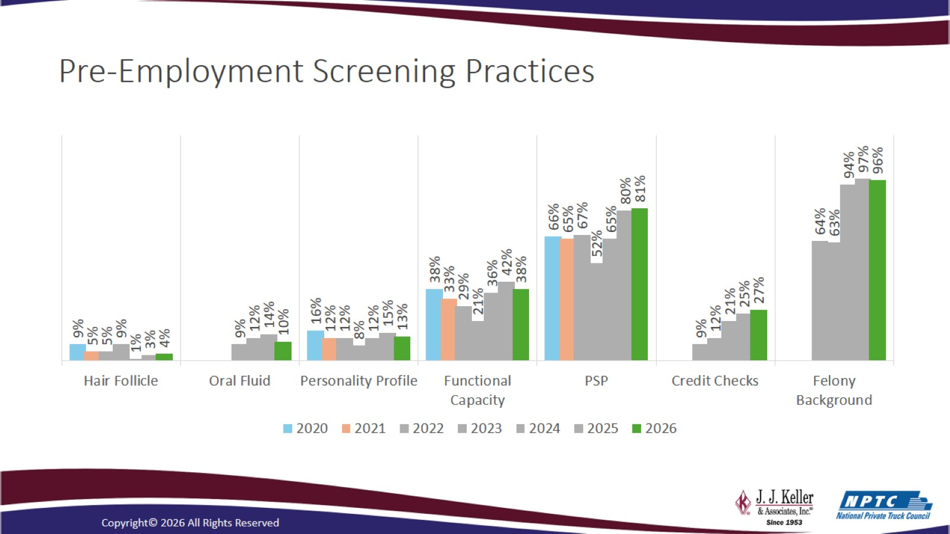
Pre-Employment Screening Practices

Slide 21
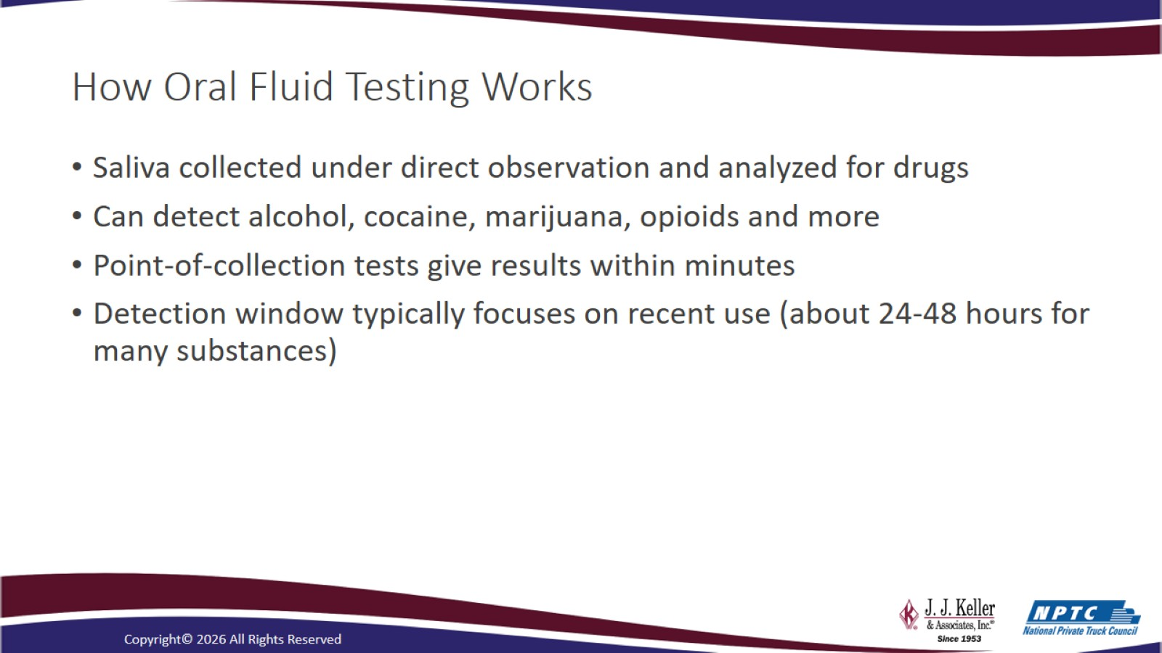
How Oral Fluid Testing Works

Slide 22
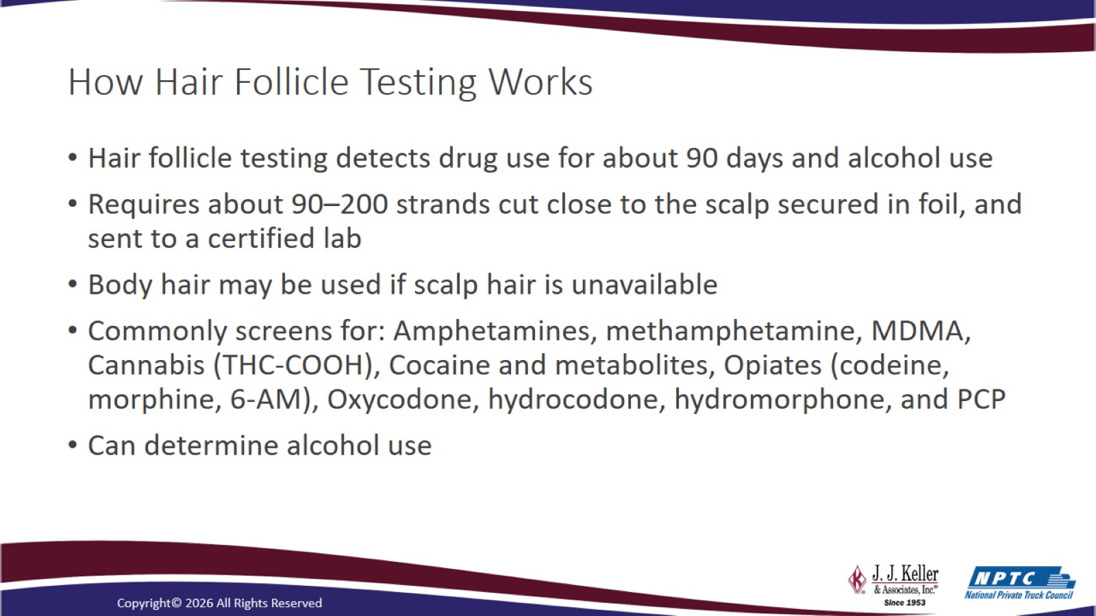
How Hair Follicle Testing Works

Slide 23
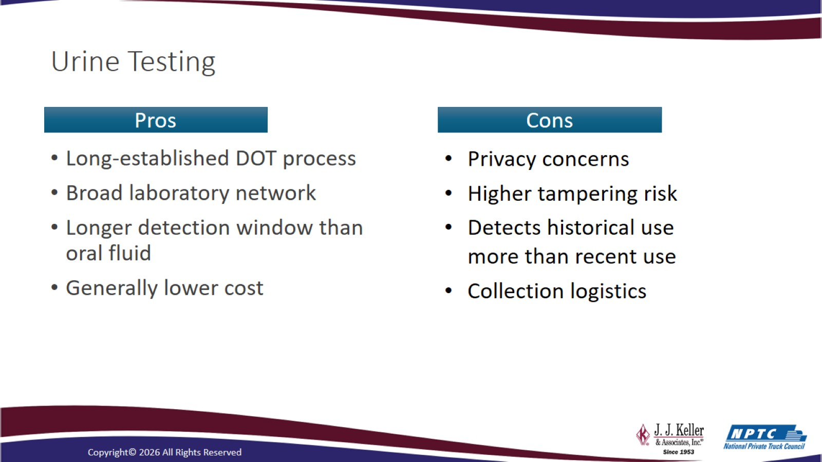
Urine Testing

Slide 24
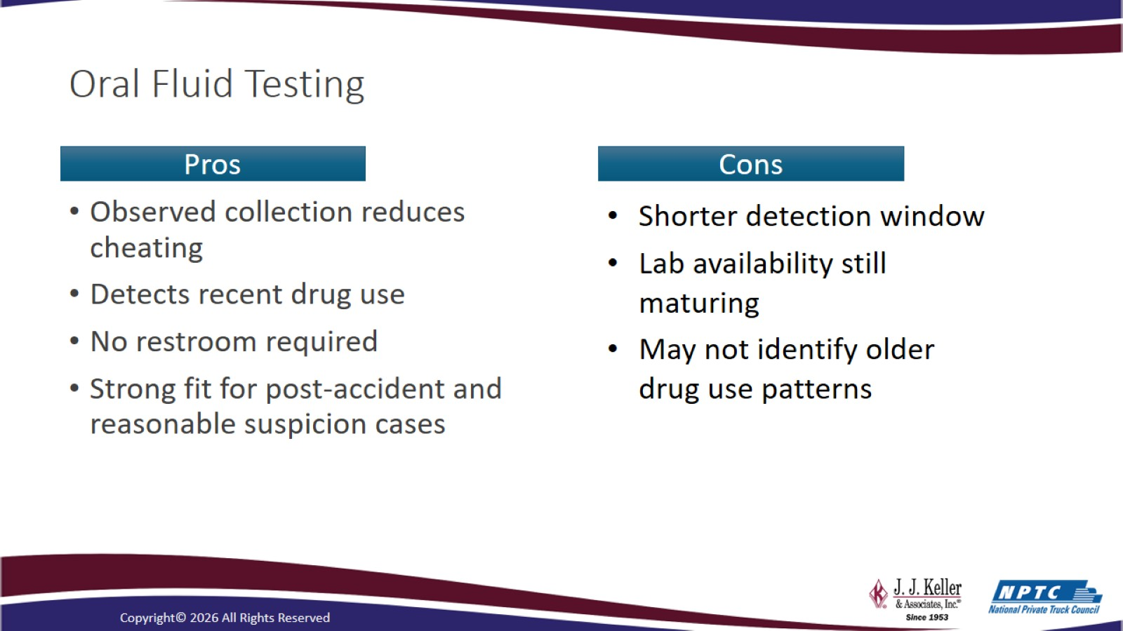
Oral Fluid Testing

Slide 25
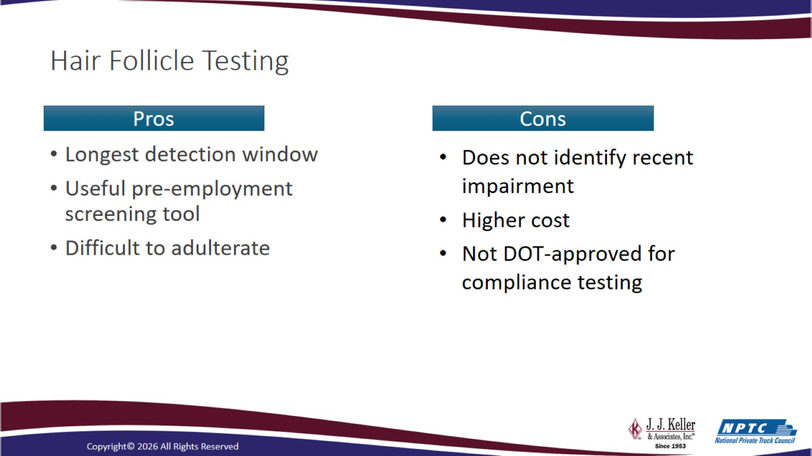
Hair Follicle Testing

Slide 26
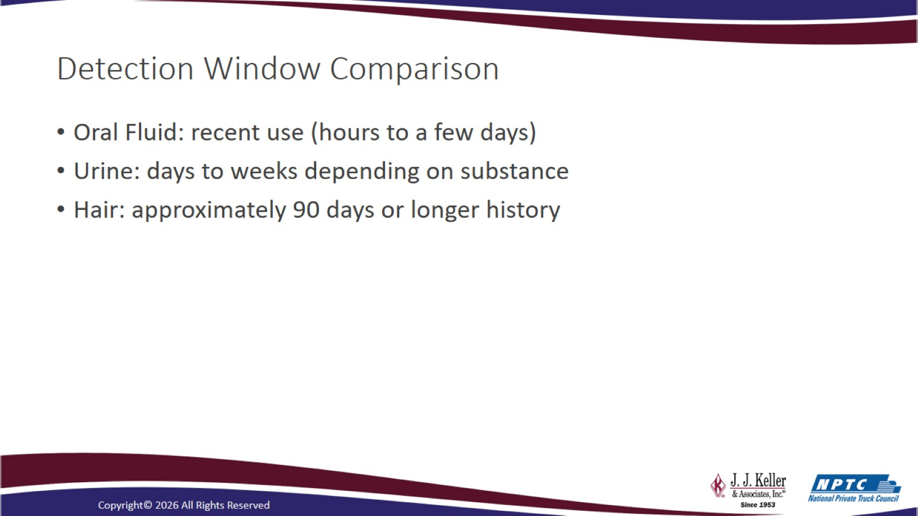
Detection Window Comparison

Slide 27
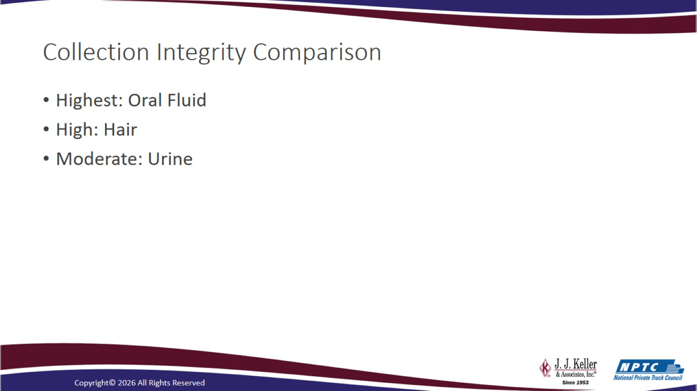
Collection Integrity Comparison

Slide 28
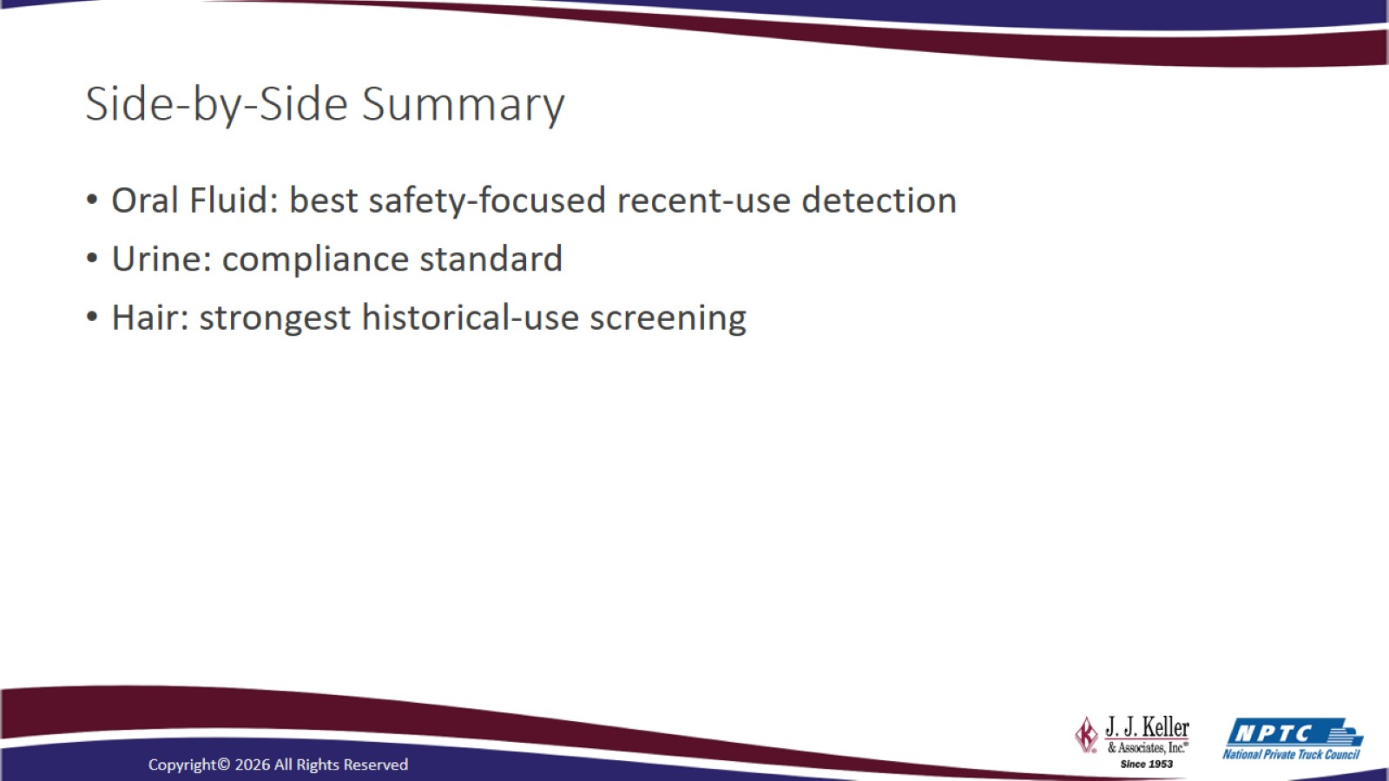
Side-by-Side Summary

Slide 29
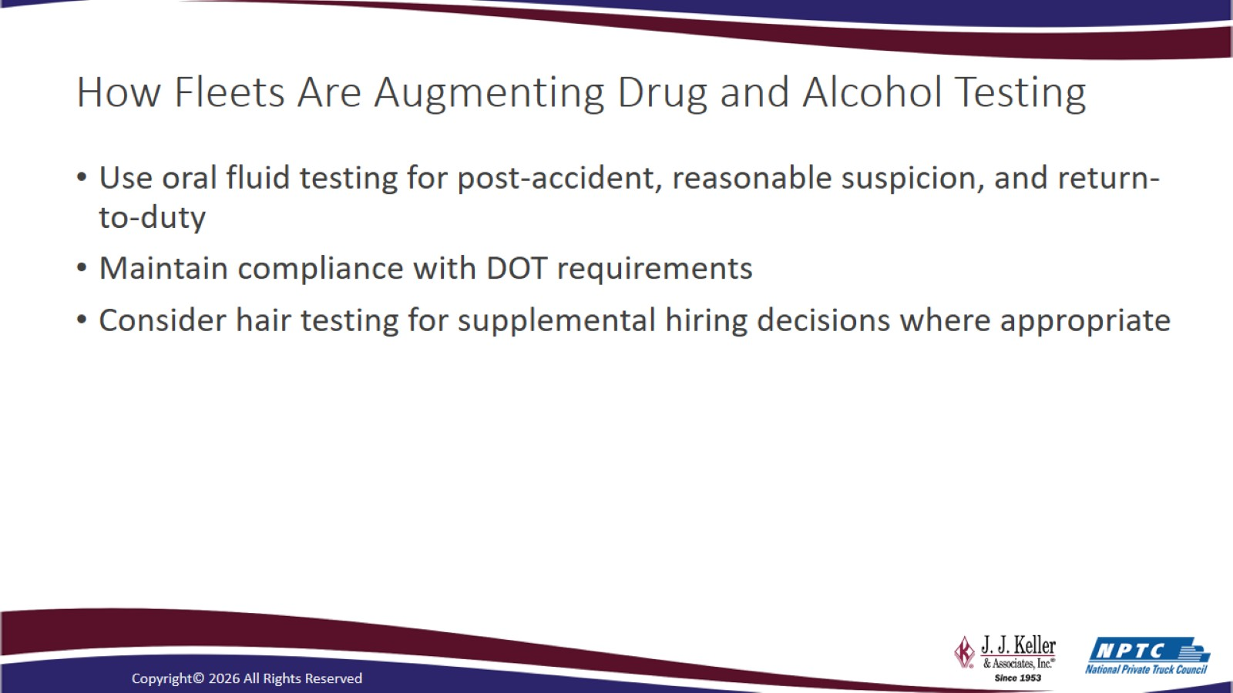
How Fleets Are Augmenting Drug and Alcohol Testing

Slide 30
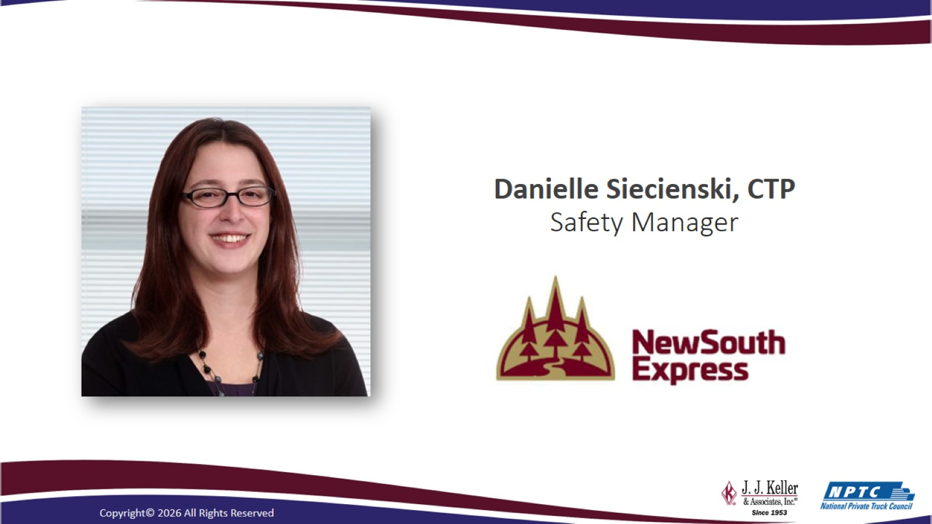

Slide 31
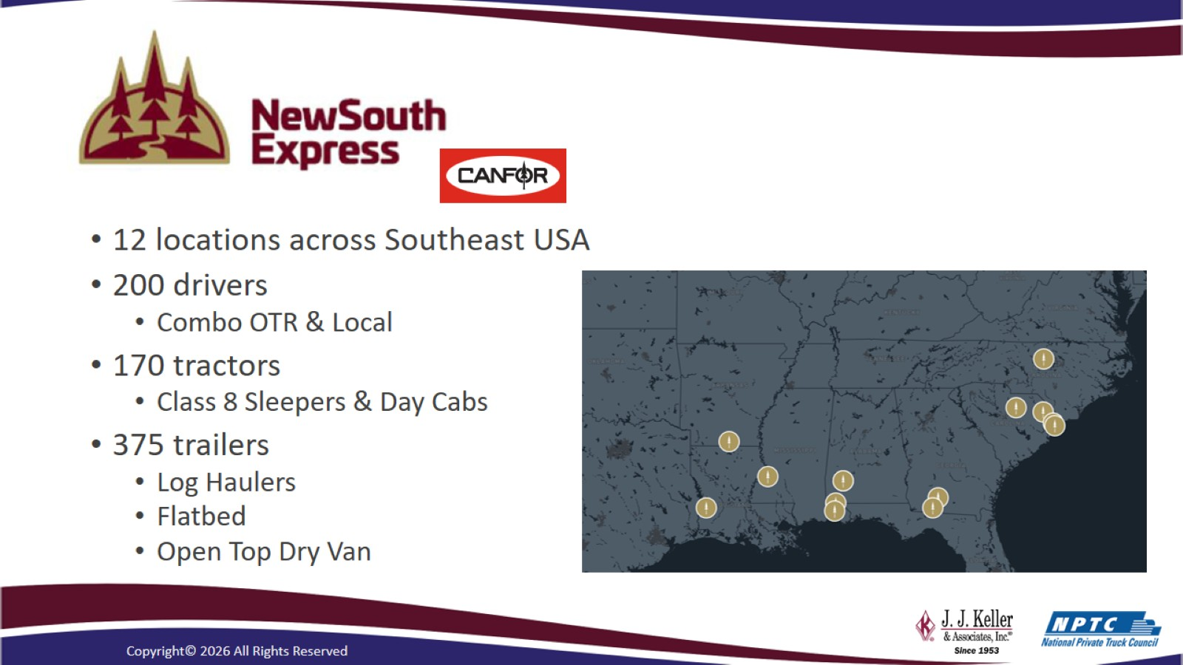

Slide 32
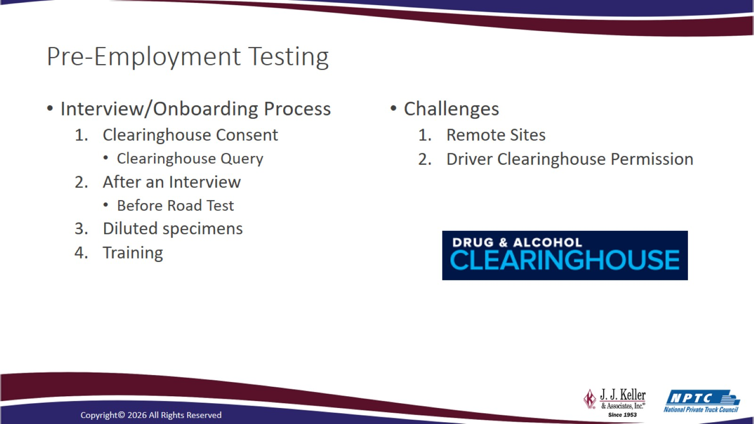
Pre-Employment Testing

Slide 33
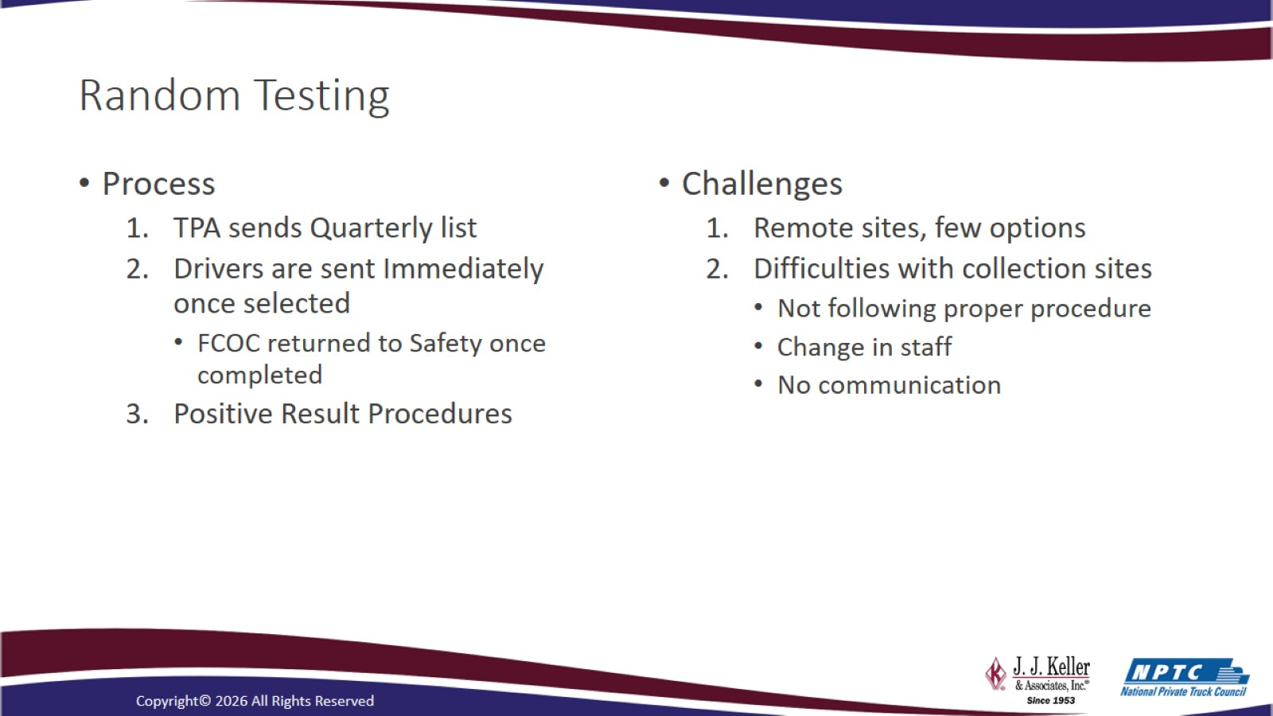
Random Testing

Slide 34
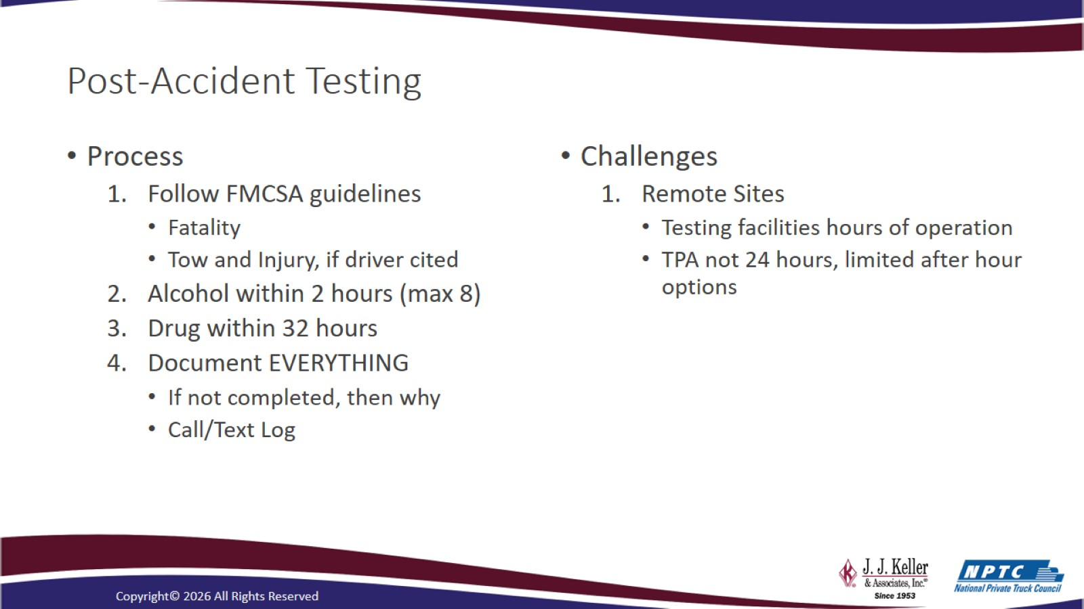
Post-Accident Testing

Slide 35
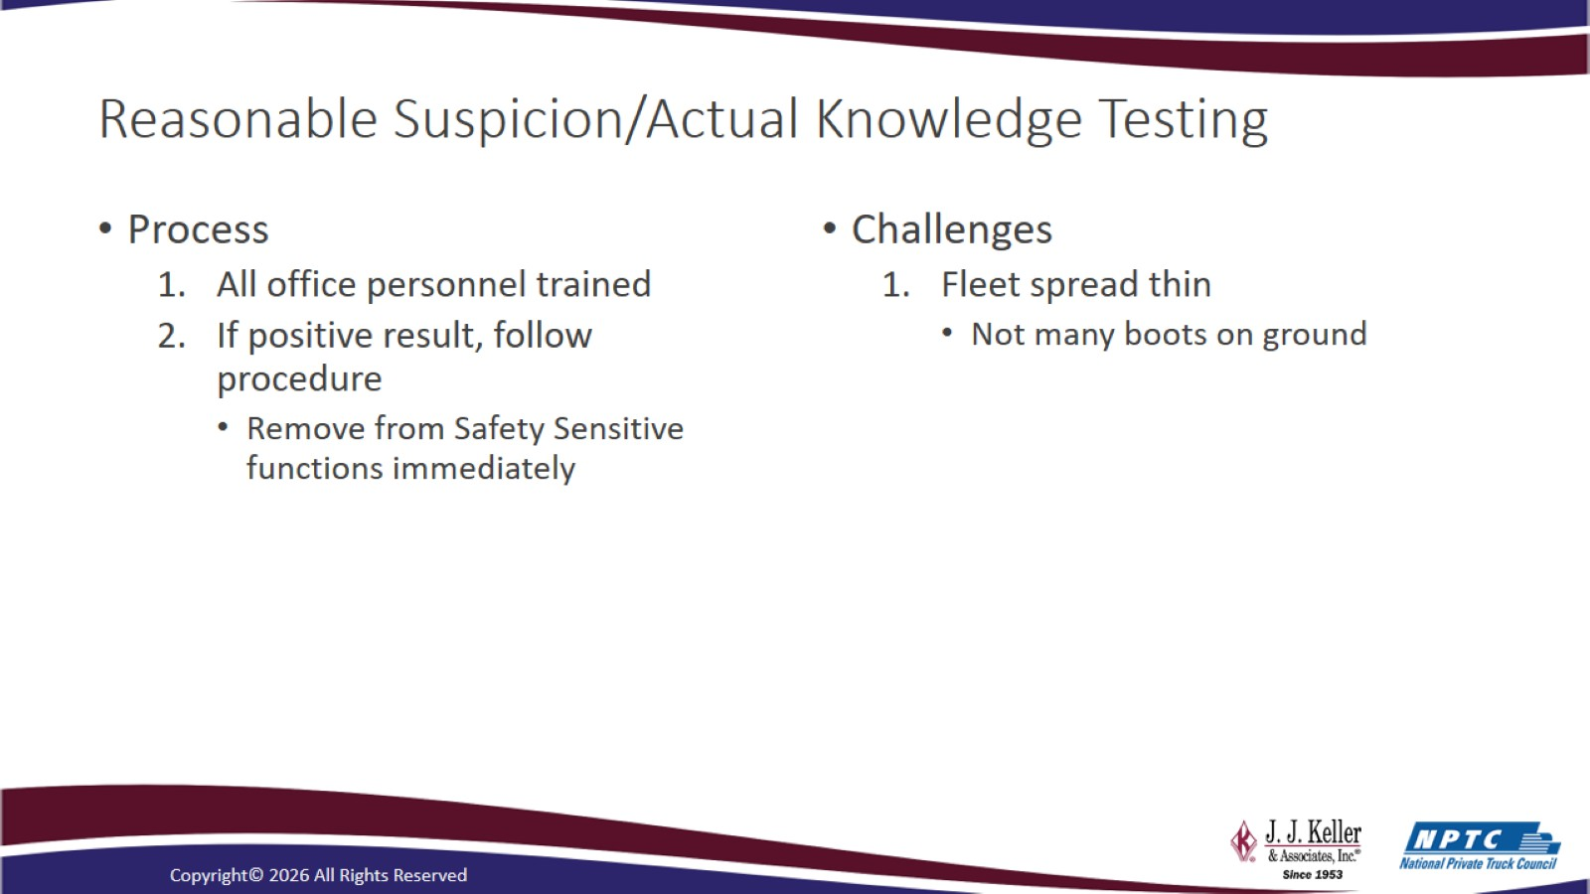
Reasonable Suspicion/Actual Knowledge Testing

Slide 36
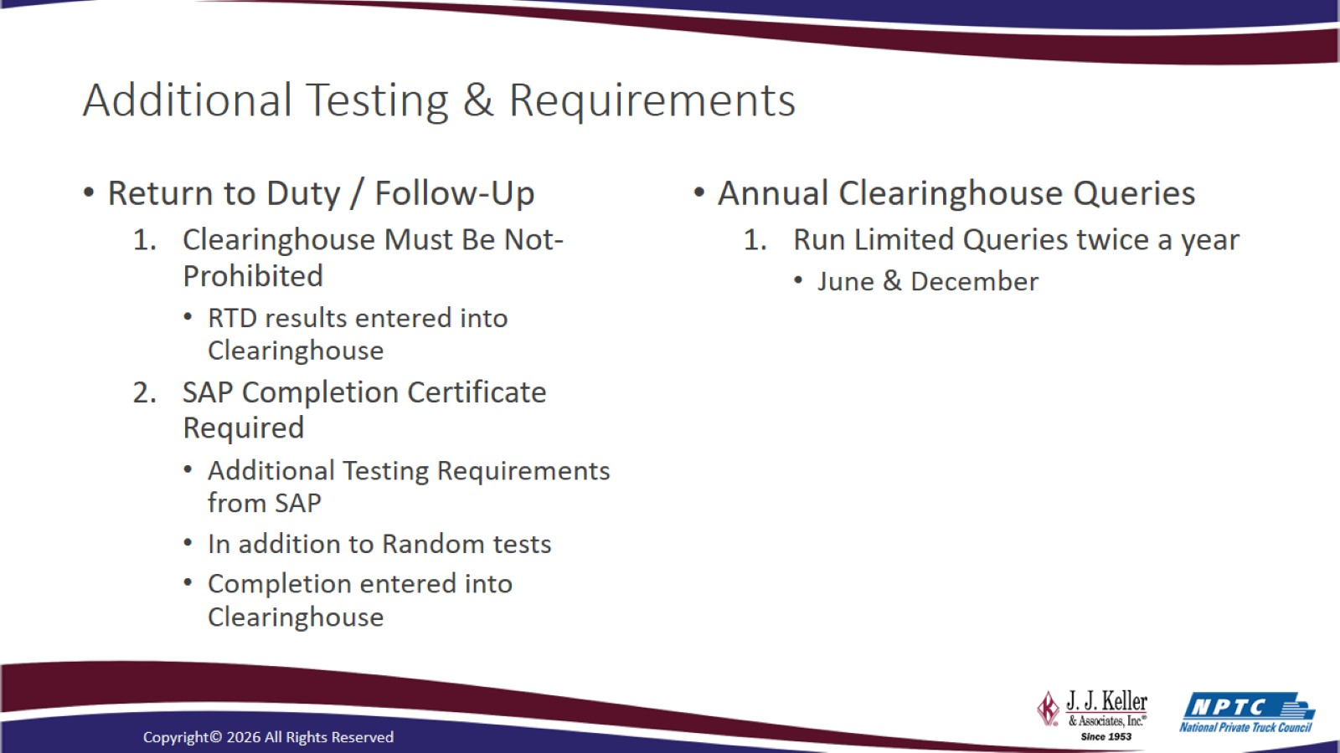
Additional Testing & Requirements

Slide 37
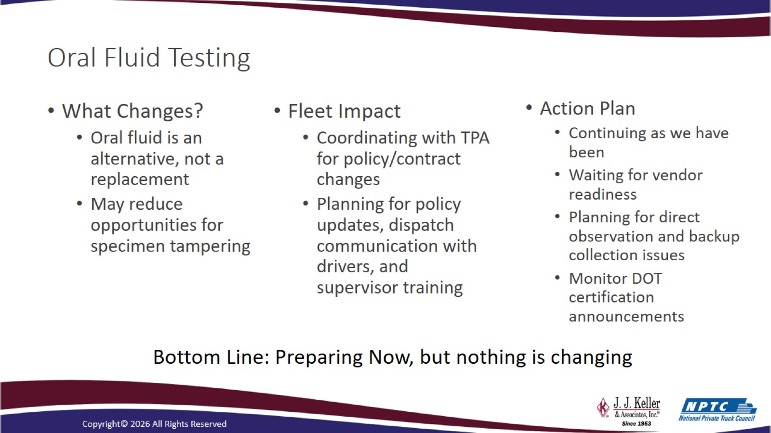
Oral Fluid Testing

Slide 38

Questions and Answers

Slide 39
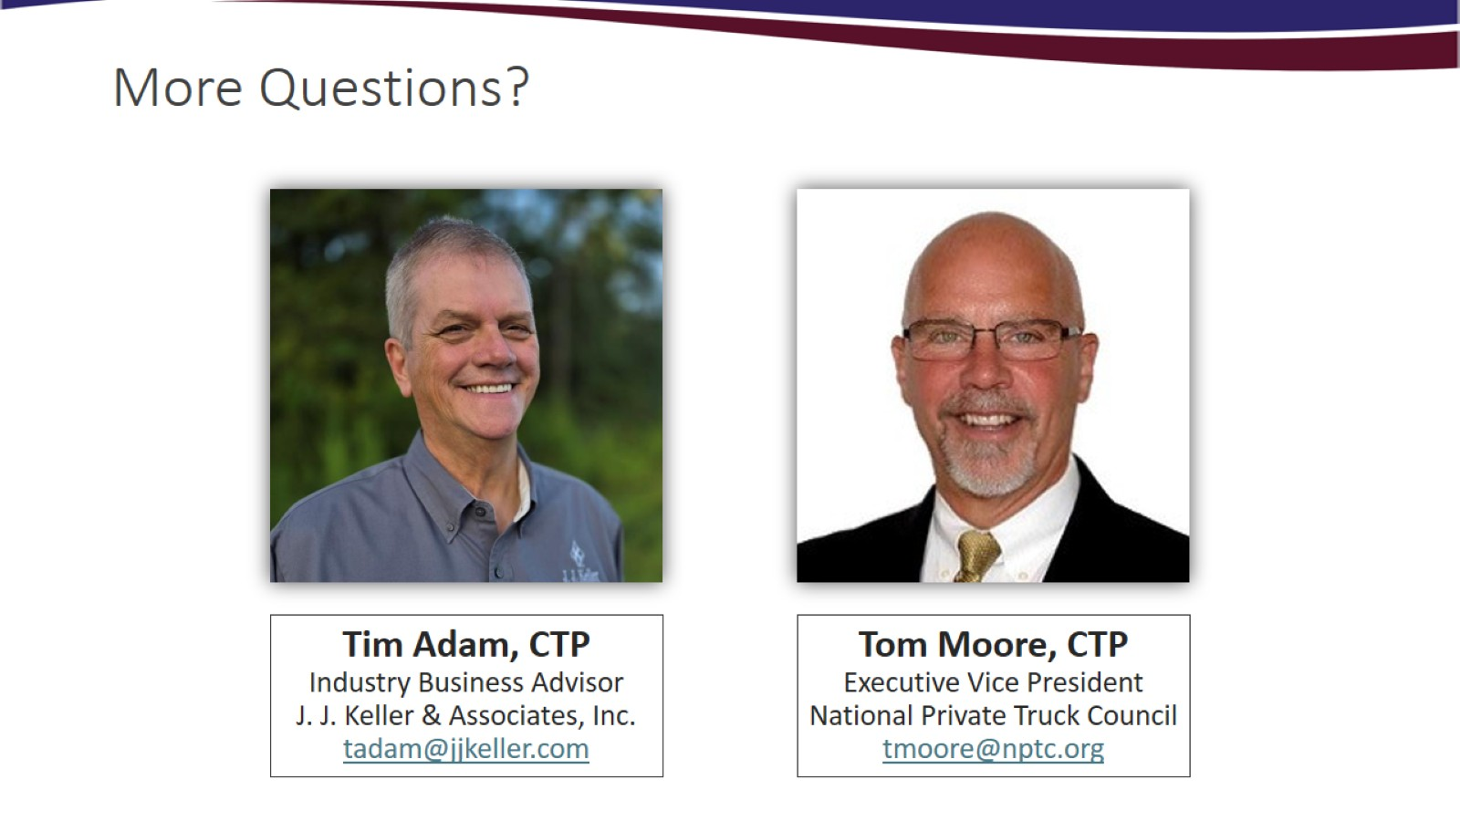
More Questions?

Slide 40

Thank you… Please join us in 2027!
Visit: www.jjkeller.com/nptcinfo for today’s presentation and to learn more about future NPTC and J. J. Keller webcasts

Slide 41
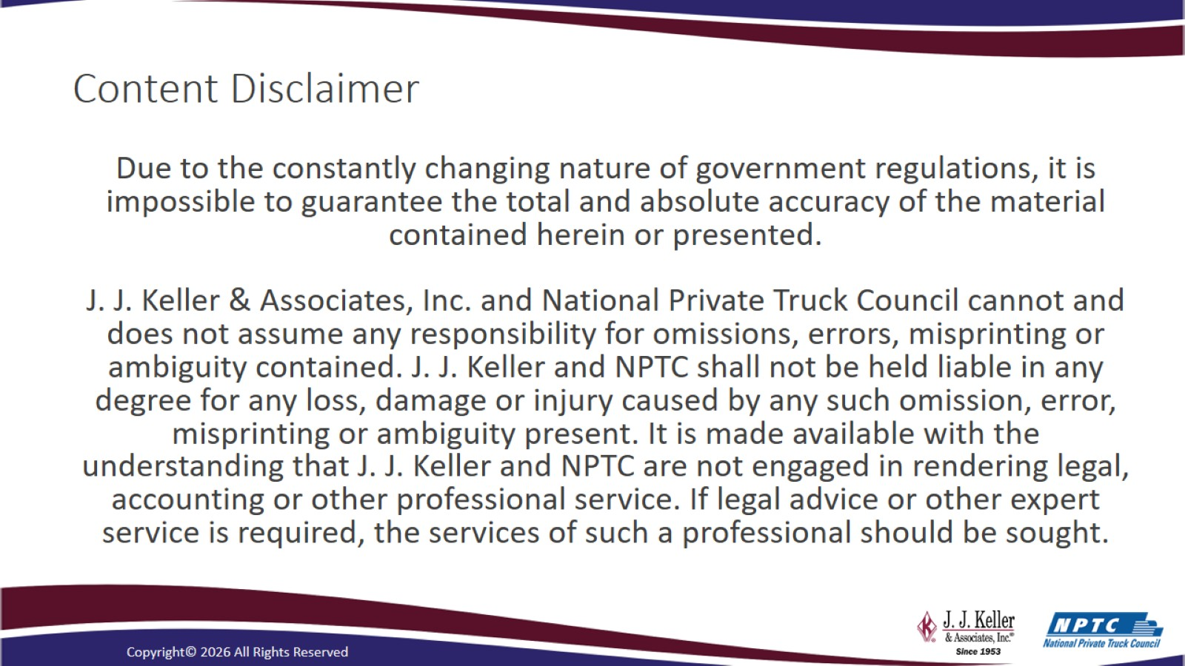
Content Disclaimer

